Slide 1
Fitting Models to Data
Calum Gabbutt
14 June 2022

Slide 2
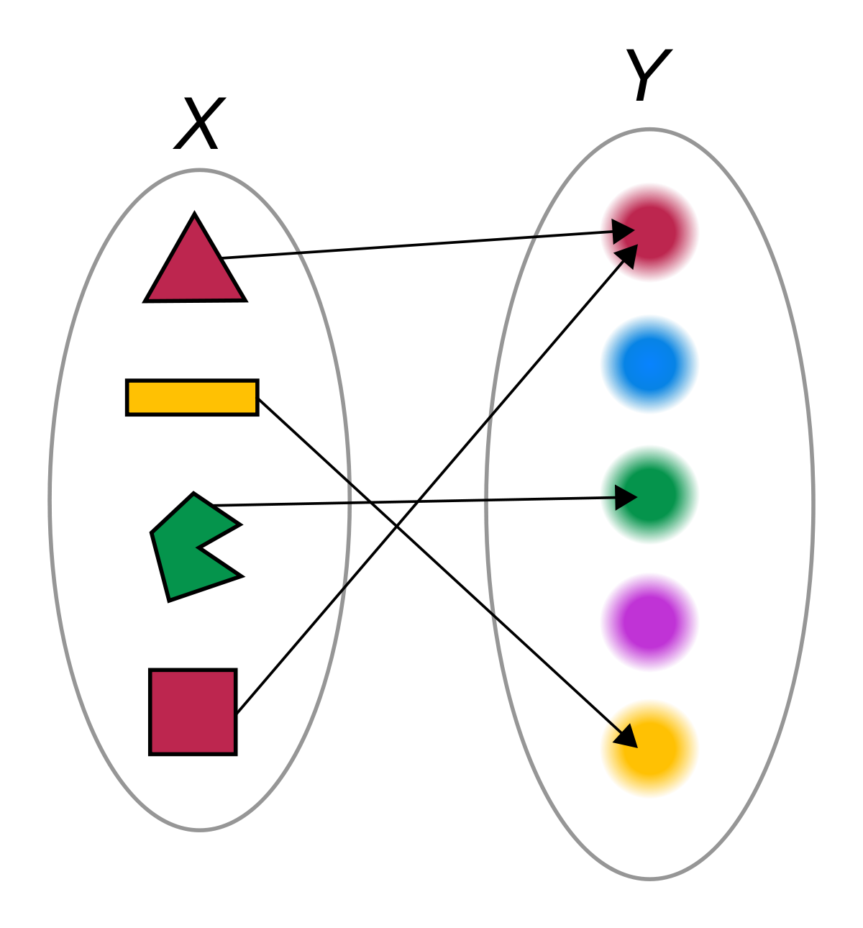
Models as a mapping
Our understanding of the natural world is couched in models
Generative mathematical models map the complex underlying biology (i.e. parameters) to the data we measure
Fitting those models solves the inverse problem, inferring the values of model parameters consistent with the data

Slide 3
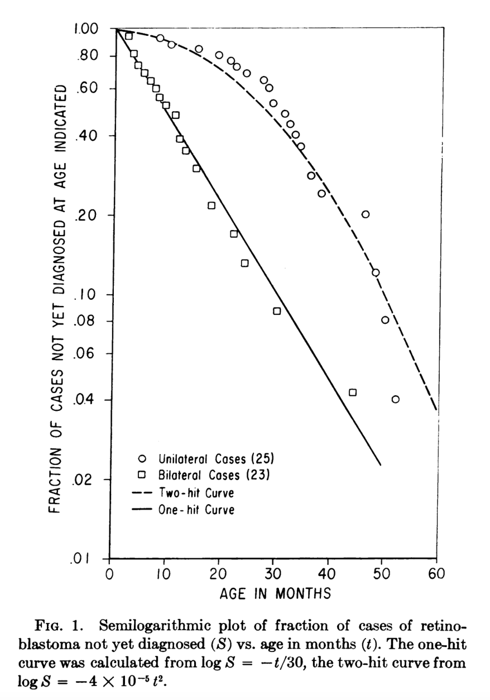
Why is modelling important?
By expressing models in mathematical terms, we are better able to define the predictions of a given model and compare different models to each other
Testing models allows one to understand what aspects of a system are important
Writing down a model mathematically forces you to acknowledge the assumptions underlying it
Models can guide experimental design
Modelling allows for well-defined null hypothesis to be constructed
If we fit a model to what has happened in the past, we may be able to predict what will happen in the future
Knudson 1971

Slide 4
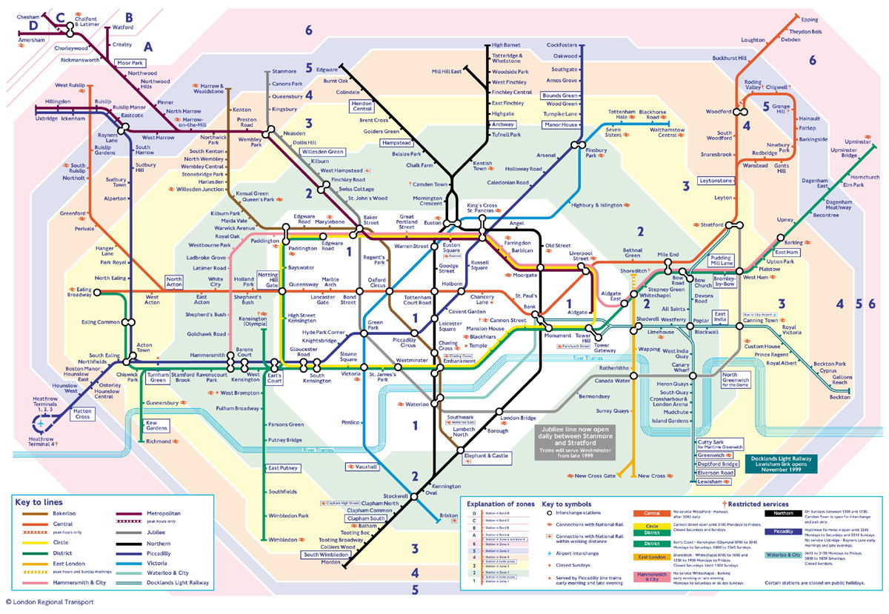

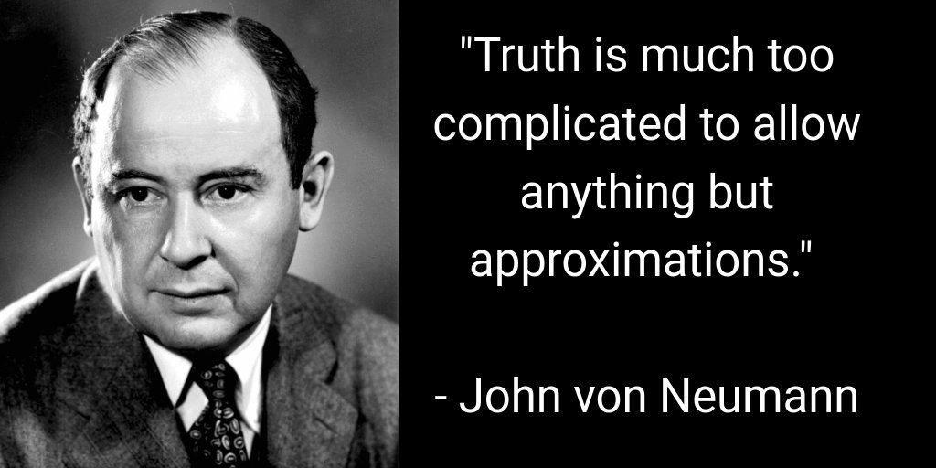
How simple is too simple?
All models (whether quantitative or qualitative) rely on approximations and simplifications
Overly complex models are prone to overfitting
The goal of the modeller is to make your model as simple as possible, but no simpler
You can compare different model fits explicitly to determine the “best” (e.g. BIC, AIC, etc.)
The degree of accuracy required of a model is determined by its purpose
You can use Newtonian dynamics to put a satellite in orbit, but you need General Relativity for GPS
Which of these is a ”better” model of London?

Slide 5
The lifecycle of a model
Test model predictions
Define biological question
Build/refine a model
Fit model to data

Slide 6
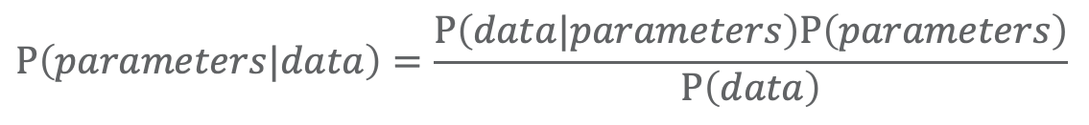
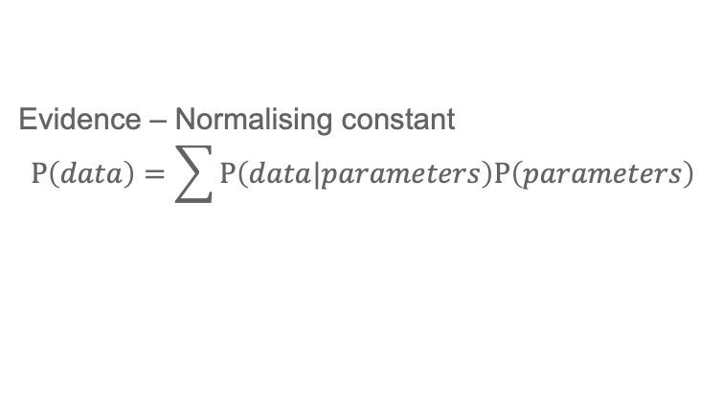
Bayes rule – A framework for fitting models to data
Prior – Encodes the investigator’s subjective beliefs about the reasonable range of the parameters
Likelihood – Encodes what we would expect the data to look like, given a certain set of parameters
$$P\left(parameters|data\right)=\frac{P\left(data|parameters\right)P\left(parameters\right)}{P\left(data\right)}$$
Posterior – Updated belief in the parameters after the model fit
Evidence – Normalising constant
$$P\left(data\right)=\sum{P\left(data|parameters\right)P\left(parameters\right)}$$
Notes:
Difference compared to MLE - There may be many parameter combinations with very similar likelihoods and the likelihood surface may be multi-modal, making global optimisation difficult
Priors regularise problem (ruling out implausible regions of the parameter space)
Rather than simple point estimates for parameter values, can get plausible ranges of values, together with information on parameter identifiability and confounding

Slide 7
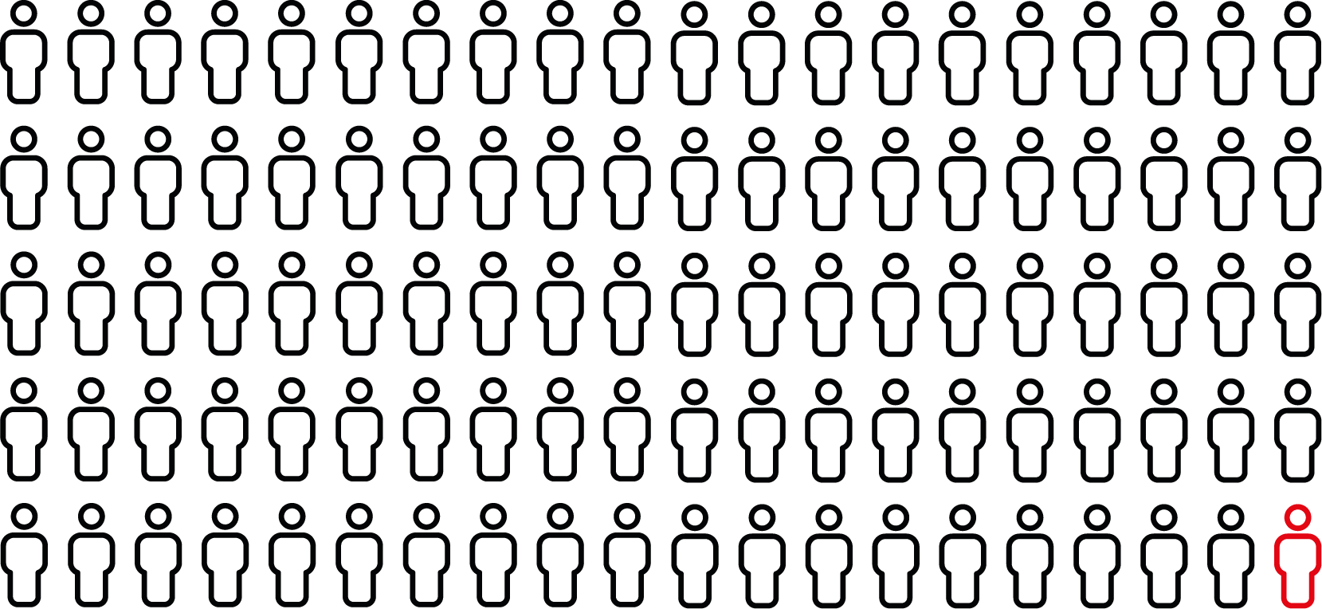
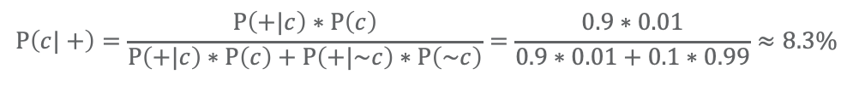
Bayes rule and cancer screening
90% of cancers are detected
90 test positive
Imagine a cancer screening test that detects a particular type of cancer (1% prevalence in the population) with a sensitivity and specificity of 90% - what is the probability that a person who has just tested positive actually has cancer?
1% of population has cancer
100 cancer
10 test negative
10,000 people
10% of patients without cancer are incorrectly diagnosed
990 test positive
99% of population don’t have cancer
9,900 no cancer
8,910 test negative
$$P\left(c|+\right)=\frac{P\left(+|c\right)∗P\left(c\right)}{P\left(+|c\right)∗P\left(c\right)+P\left(+|\sim c\right)∗P\left(\sim c\right)}=\frac{0.9∗0.01}{0.9∗0.01+0.1∗0.99}≈8.3\%$$

Slide 8
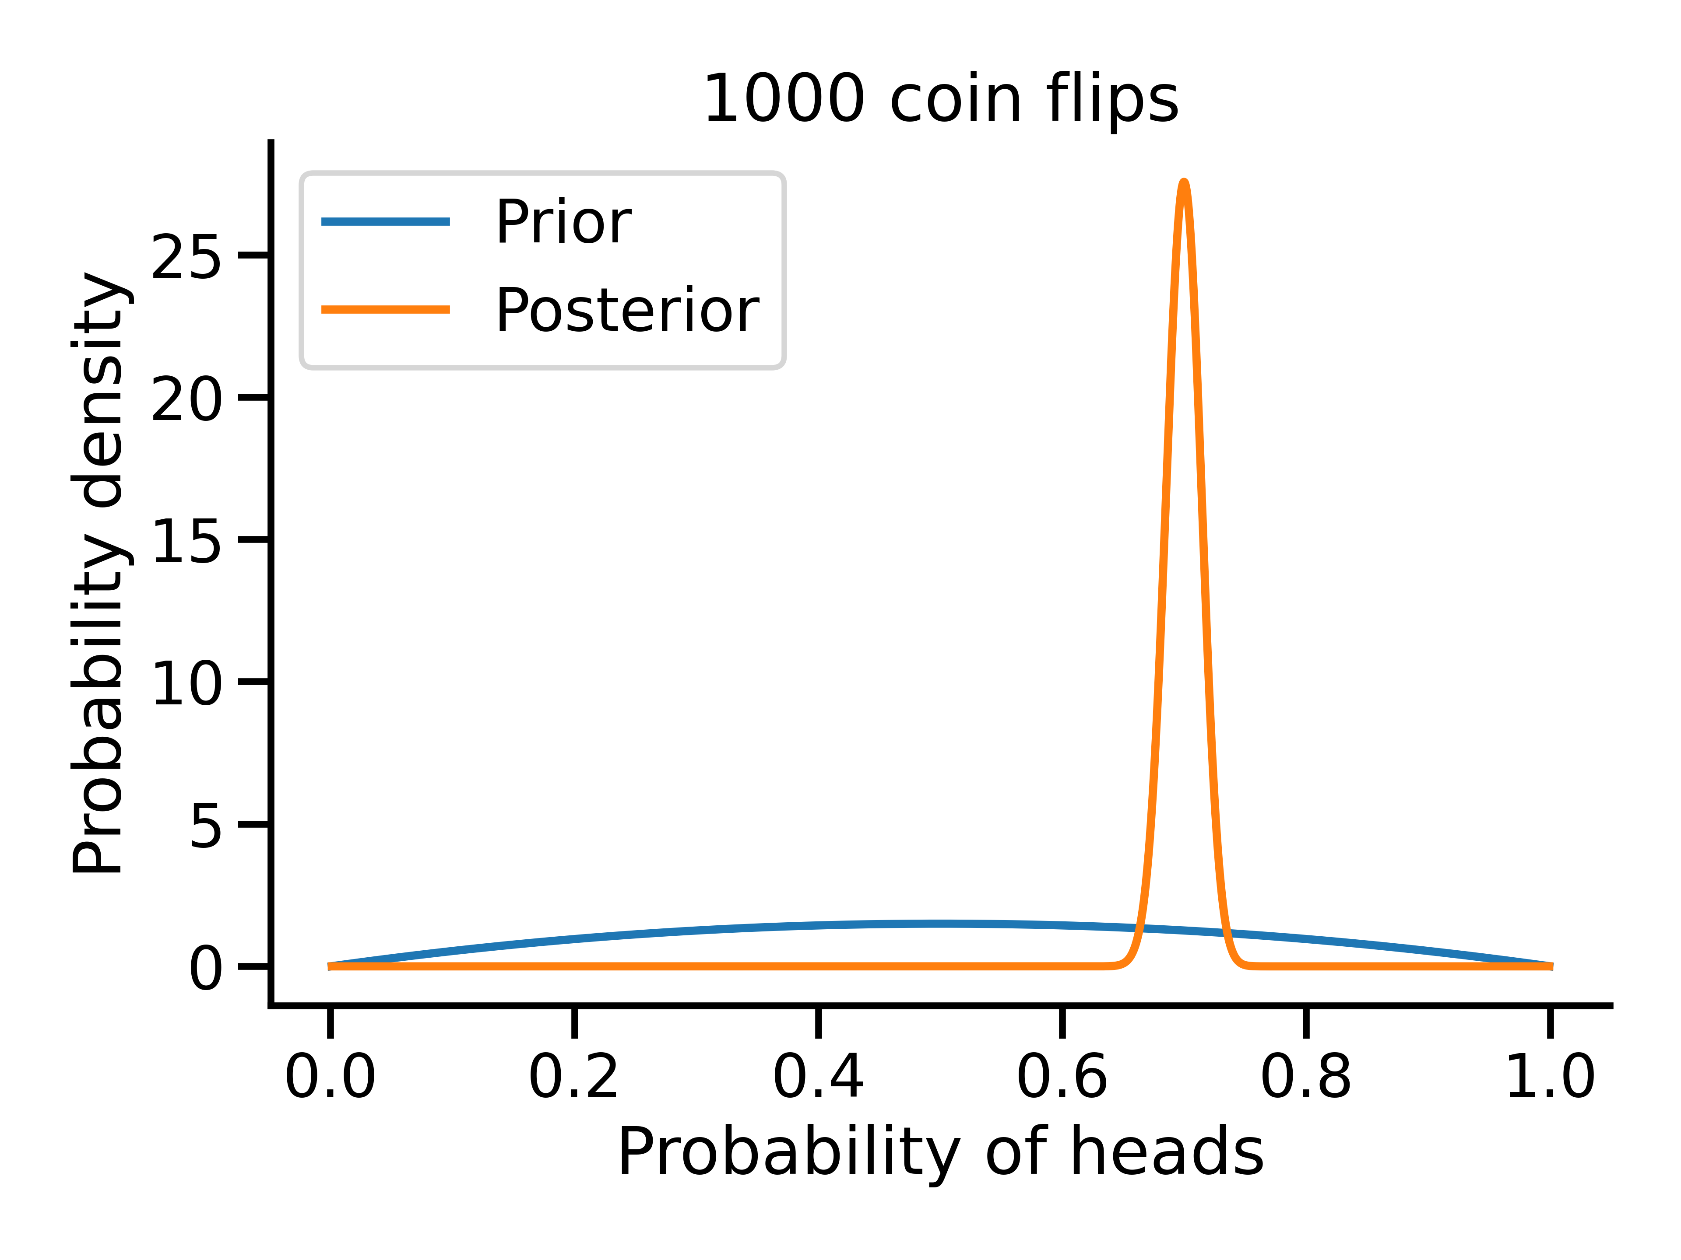
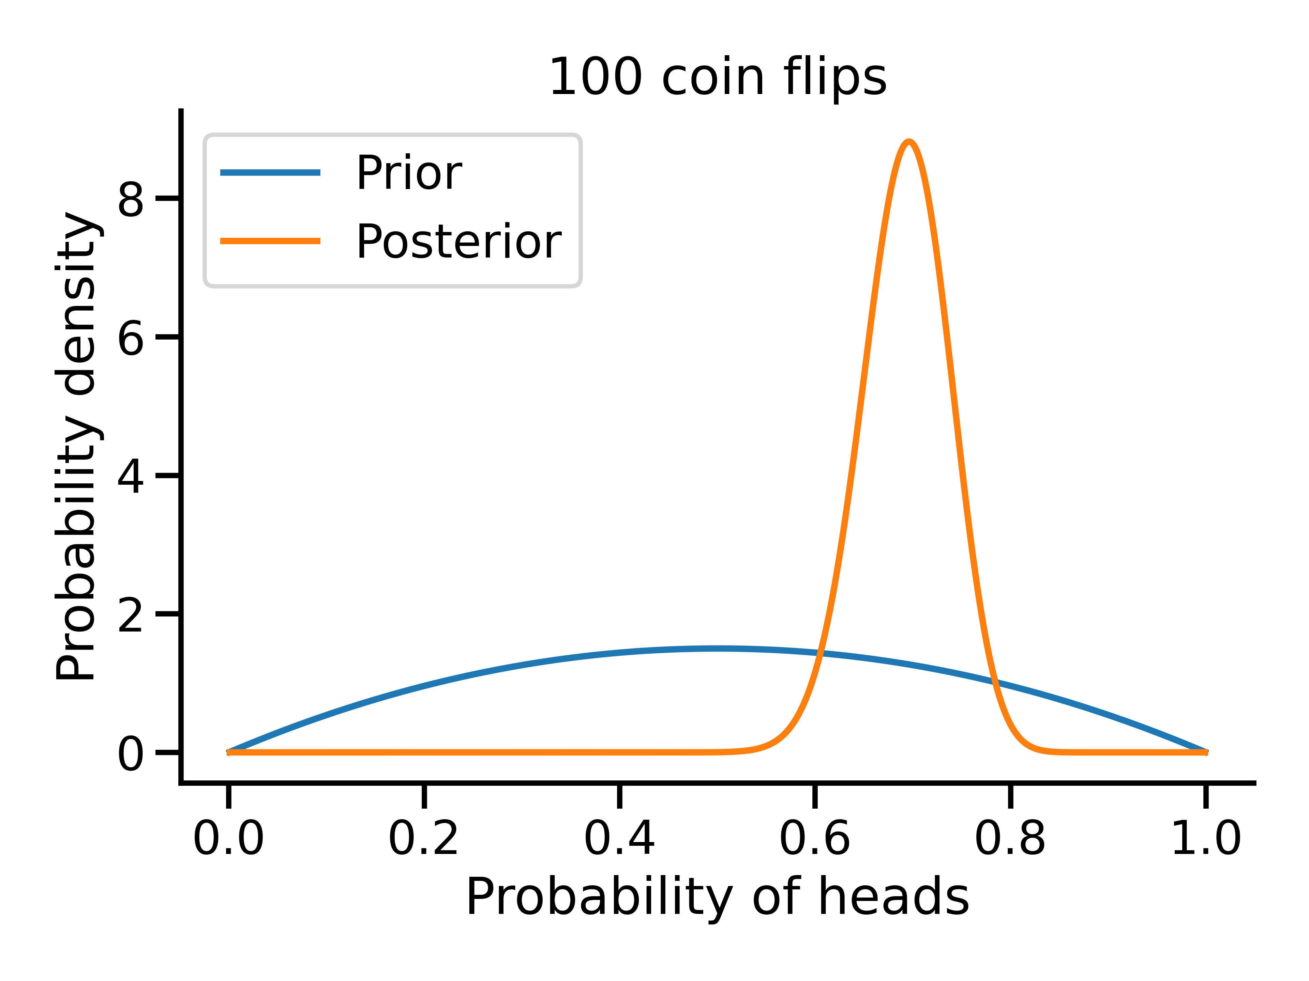
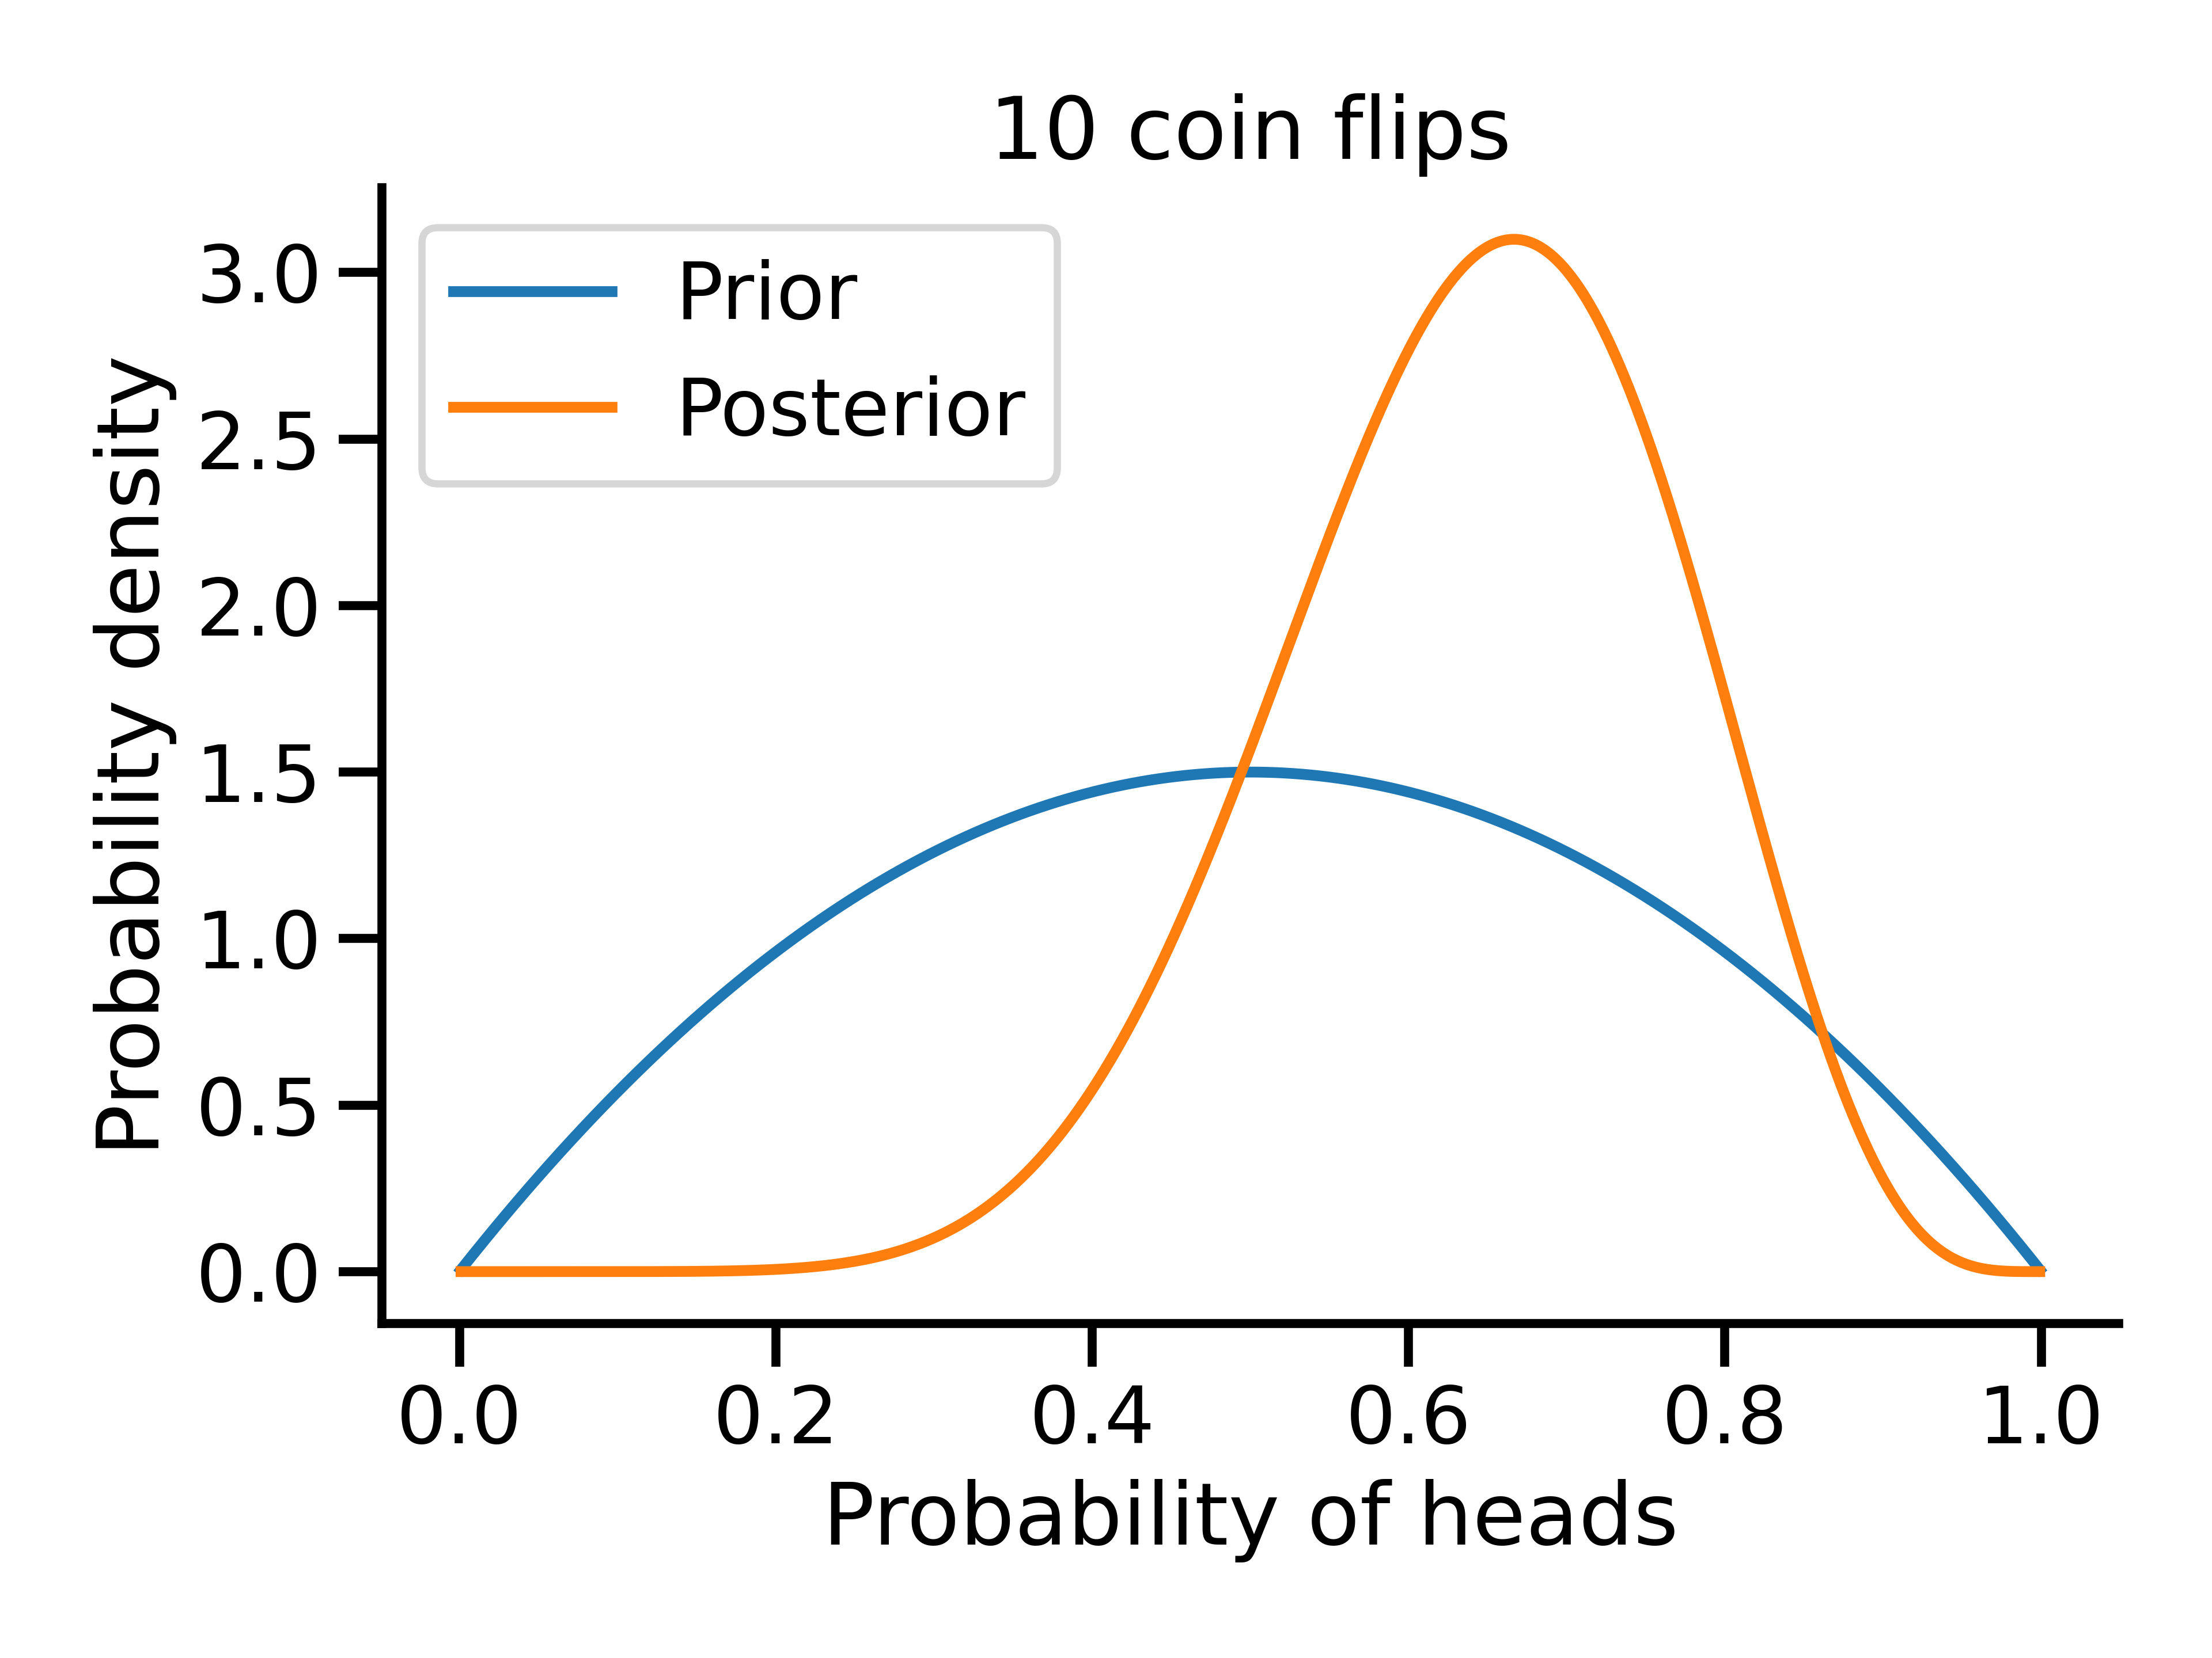
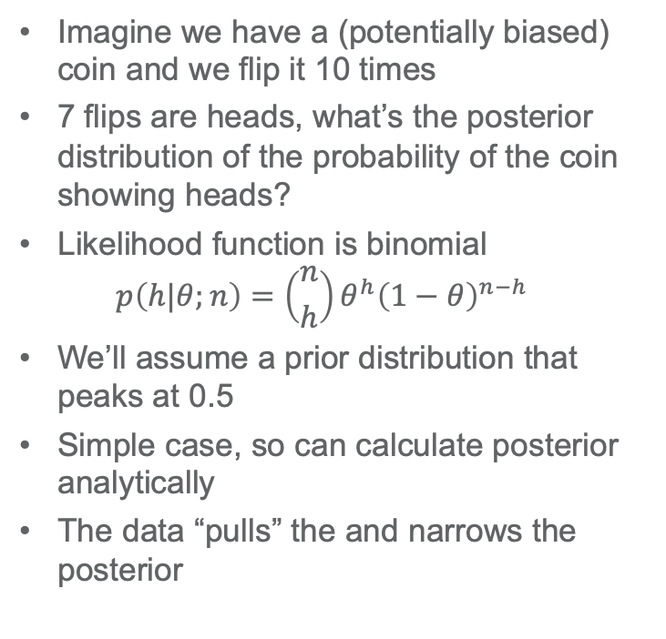
Fitting a biased coin
Imagine we have a (potentially biased) coin and we flip it 10 times
7 flips are heads, what’s the posterior distribution of the probability of the coin showing heads?
Likelihood function is binomial
$$p\left(h|θ;n\right)=\left({n \atop h}\right)θ^{h}{\left(1−θ\right)}^{n−h}$$
We’ll assume a prior distribution that peaks at 0.5
Simple case, so can calculate posterior analytically
The data “pulls” the and narrows the posterior

Slide 9
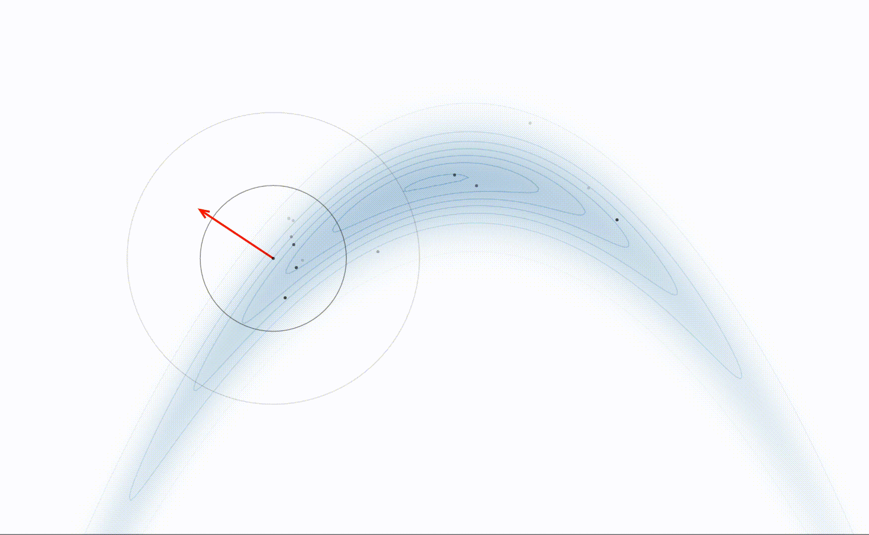

MCMC techniques
Difficulty in calculating posterior comes in integrating the normalising constant
Plethora of Bayesian inference tools to sample from the posterior when likelihood is well defined, for example:
Markov Chain Monte Carlo techniques
Metropolis-Hasting
Gibbs sampling
Hamiltonian Monte Carlo (HMC)
Nested sampling
Metropolis-Hastings
HMC

Slide 10
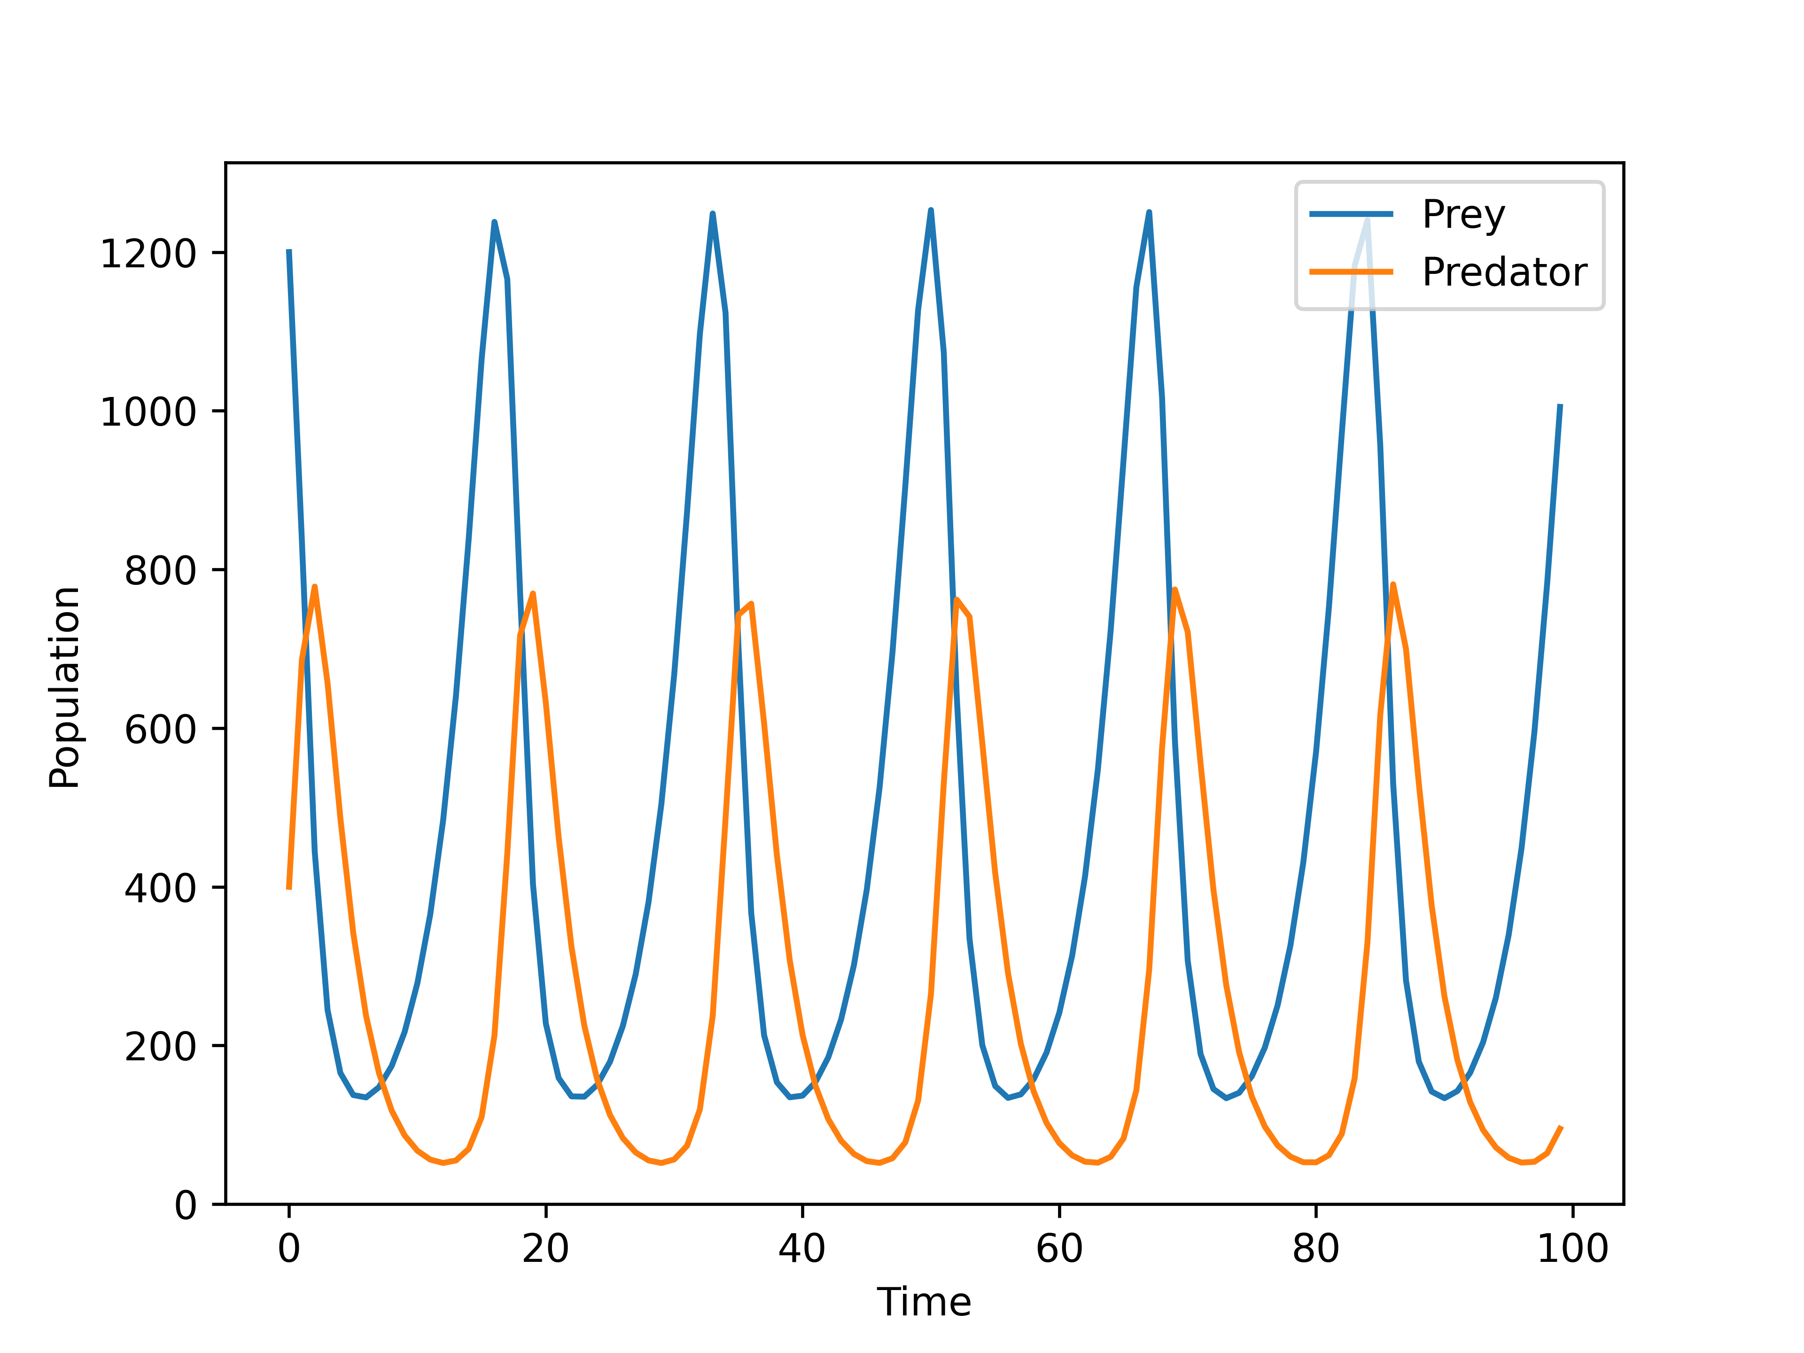
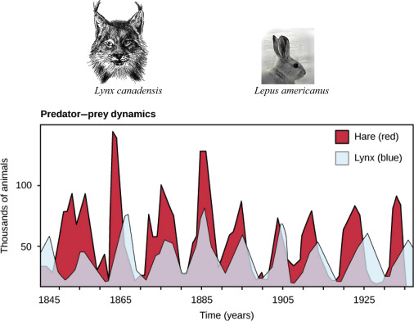
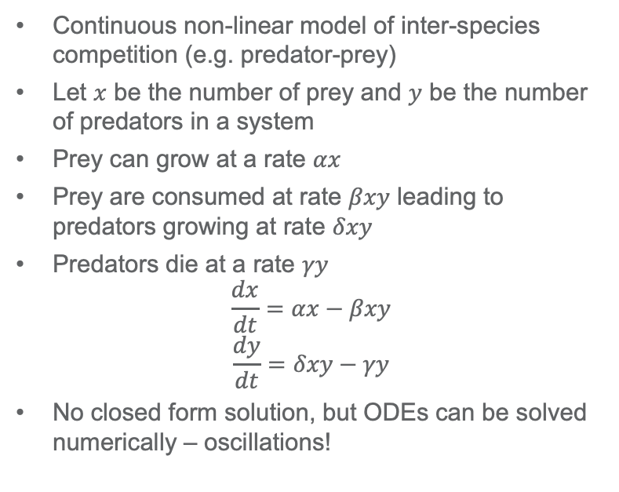
Traditional Lotka-Volterra system
Continuous non-linear model of inter-species competition (e.g. predator-prey)
Let $x$ be the number of prey and $y$ be the number of predators in a system
Prey can grow at a rate $αx$
Prey are consumed at rate $βxy$ leading to predators growing at rate $δxy$
Predators die at a rate $γy$
$$\frac{dx}{dt}=αx−βxy$$
$$\frac{dy}{dt}=δxy−γy$$
No closed form solution, but ODEs can be solved numerically – oscillations!

Slide 11
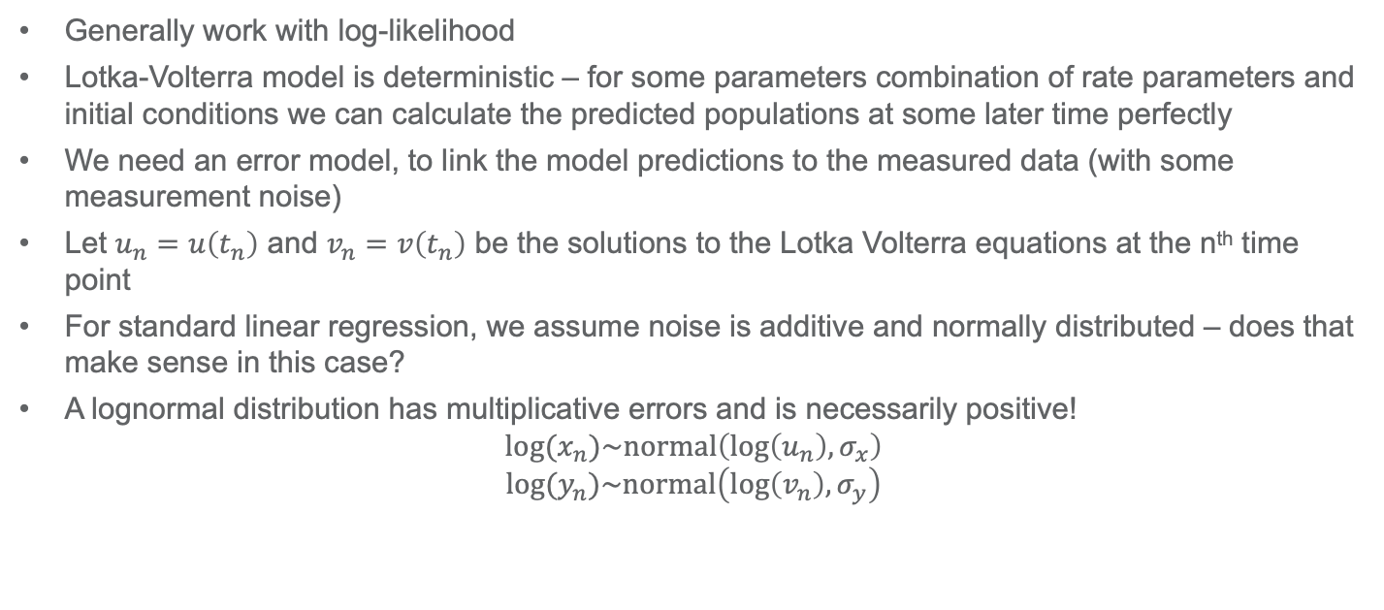
How to write a likelihood function
Generally work with log-likelihood
Lotka-Volterra model is deterministic – for some parameters combination of rate parameters and initial conditions we can calculate the predicted populations at some later time perfectly
We need an error model, to link the model predictions to the measured data (with some measurement noise)
Let $u_{n}=u\left(t_{n}\right)$ and $v_{n}=v\left(t_{n}\right)$ be the solutions to the Lotka Volterra equations at the n^{th} time point
For standard linear regression, we assume noise is additive and normally distributed – does that make sense in this case?
A lognormal distribution has multiplicative errors and is necessarily positive!
$${log⁡(x}_{n})\sim normal\left(\log\left(u_{n}\right),σ_{x}\right)$$
$${log⁡(y}_{n})\sim normal\left(\log\left(v_{n}\right),σ_{y}\right)$$

Slide 12
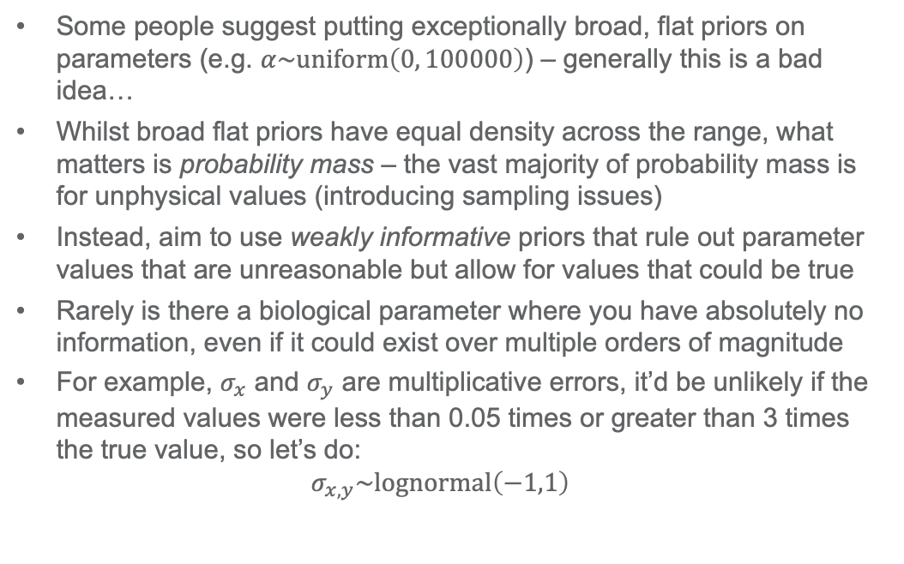
How to formulate priors
Some people suggest putting exceptionally broad, flat priors on parameters (e.g. $α\sim uniform\left(0, 100000\right)$) – generally this is a bad idea…
Whilst broad flat priors have equal density across the range, what matters is probability mass – the vast majority of probability mass is for unphysical values (introducing sampling issues)
Instead, aim to use weakly informative priors that rule out parameter values that are unreasonable but allow for values that could be true
Rarely is there a biological parameter where you have absolutely no information, even if it could exist over multiple orders of magnitude
For example, $σ_{x}$ and $σ_{y}$ are multiplicative errors, it’d be unlikely if the measured values were less than 0.05 times or greater than 3 times the true value, so let’s do:
$$σ_{x,y}\sim lognormal\left(−1,1\right)$$

Slide 13
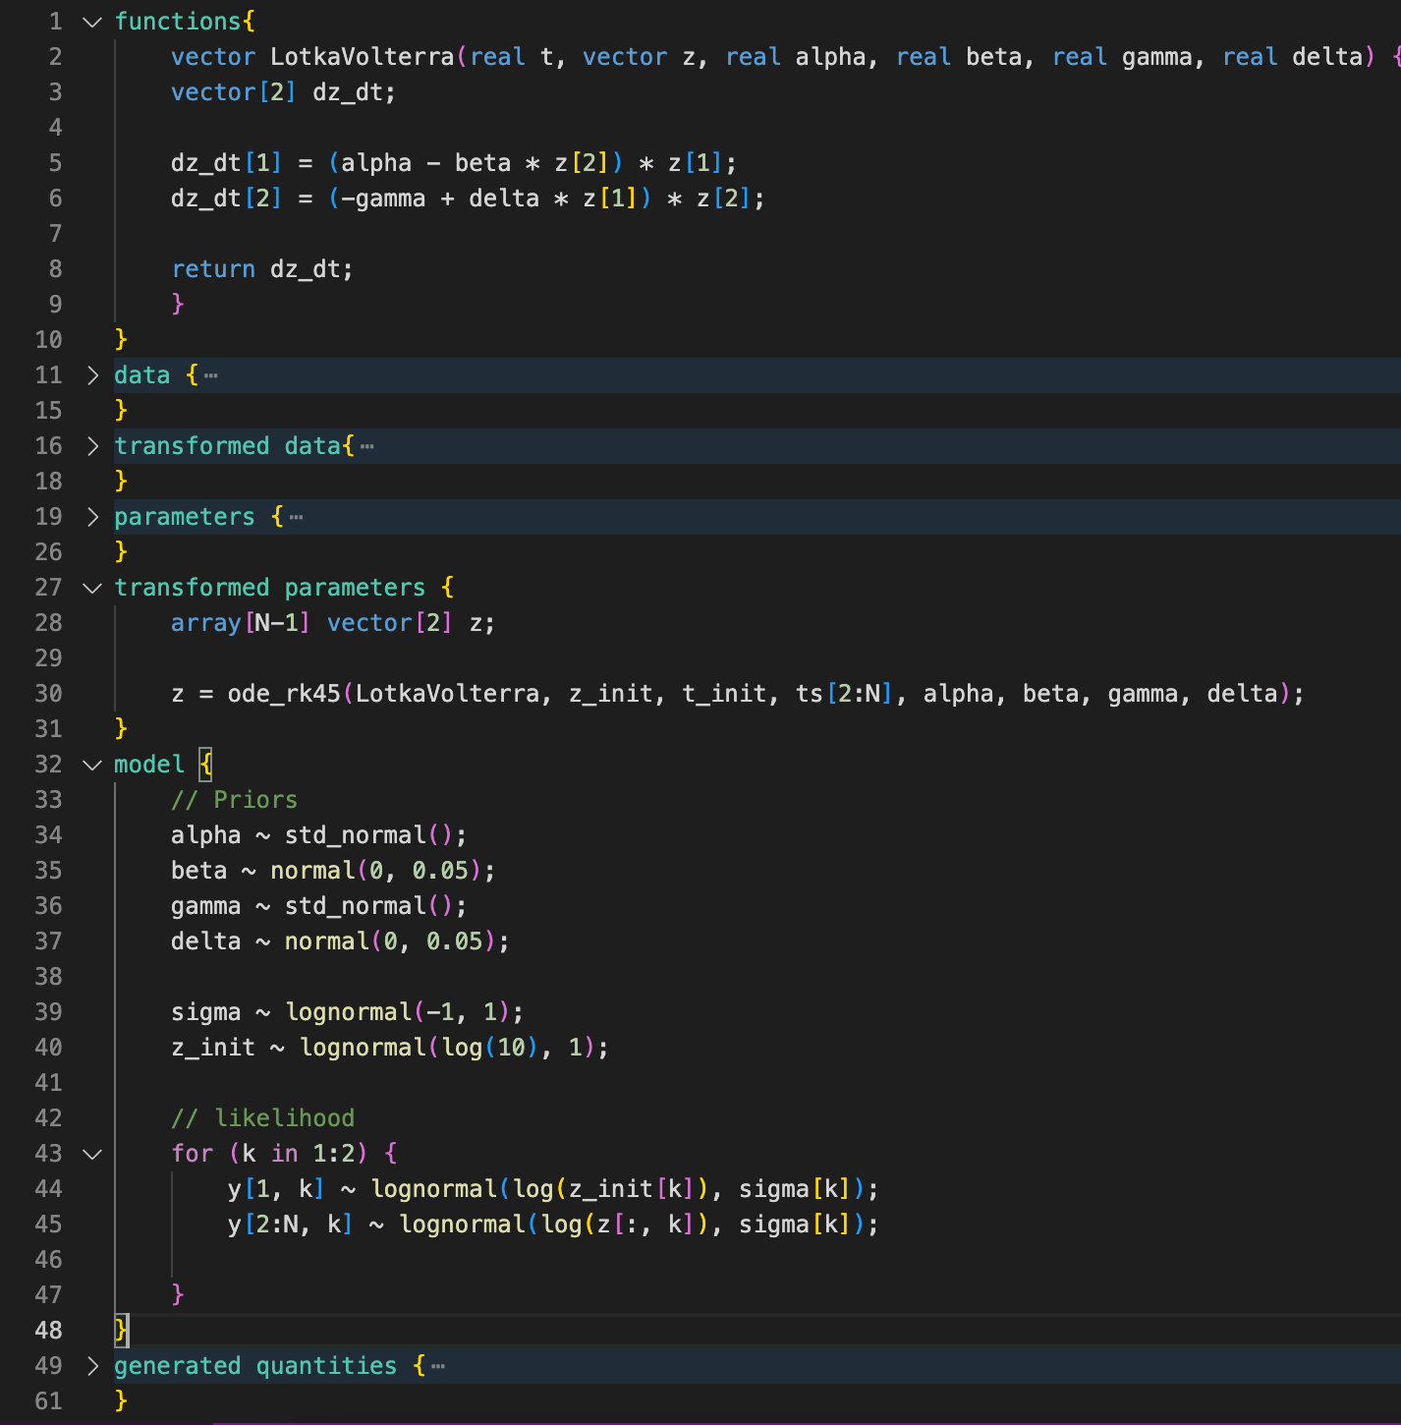
Stan example – Lotka Volterra

Slide 14
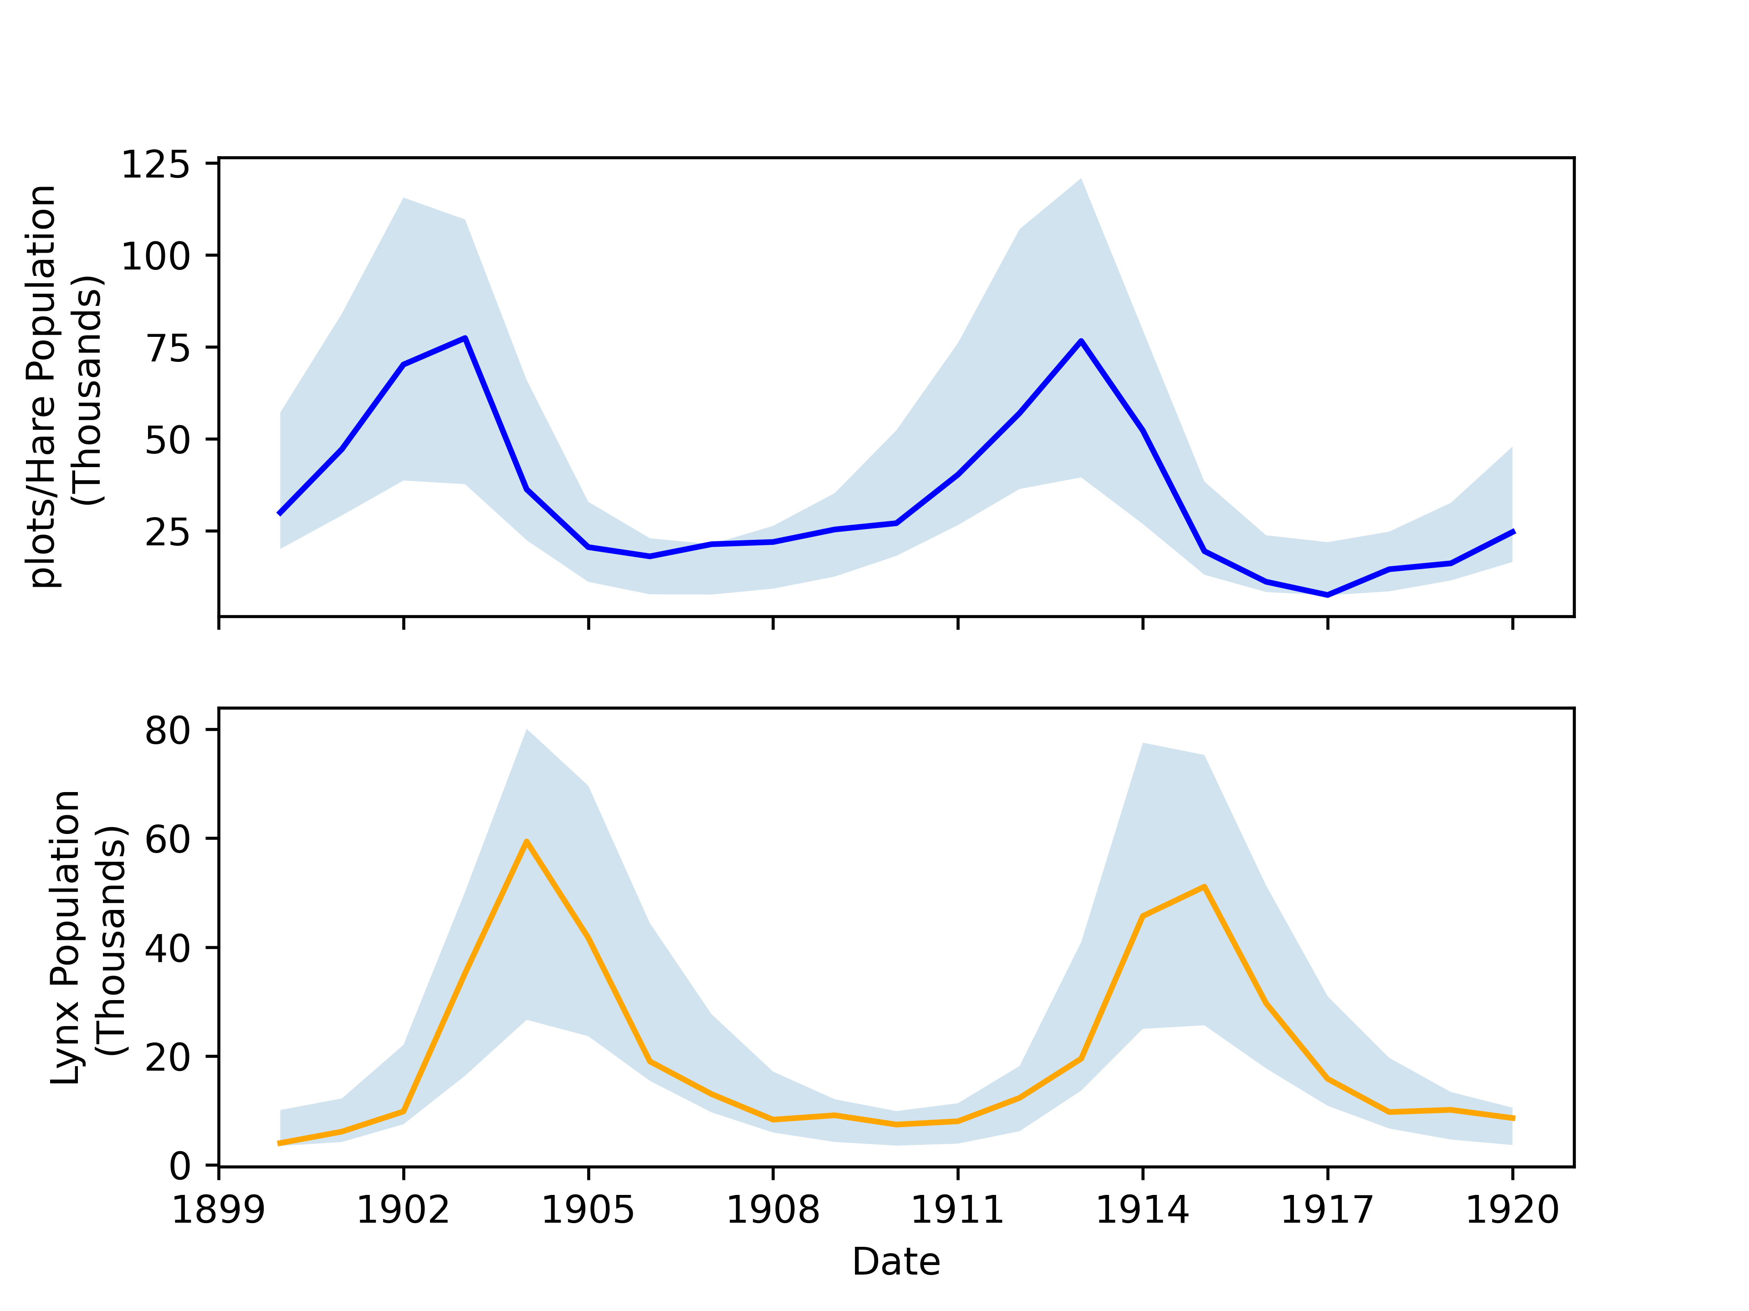
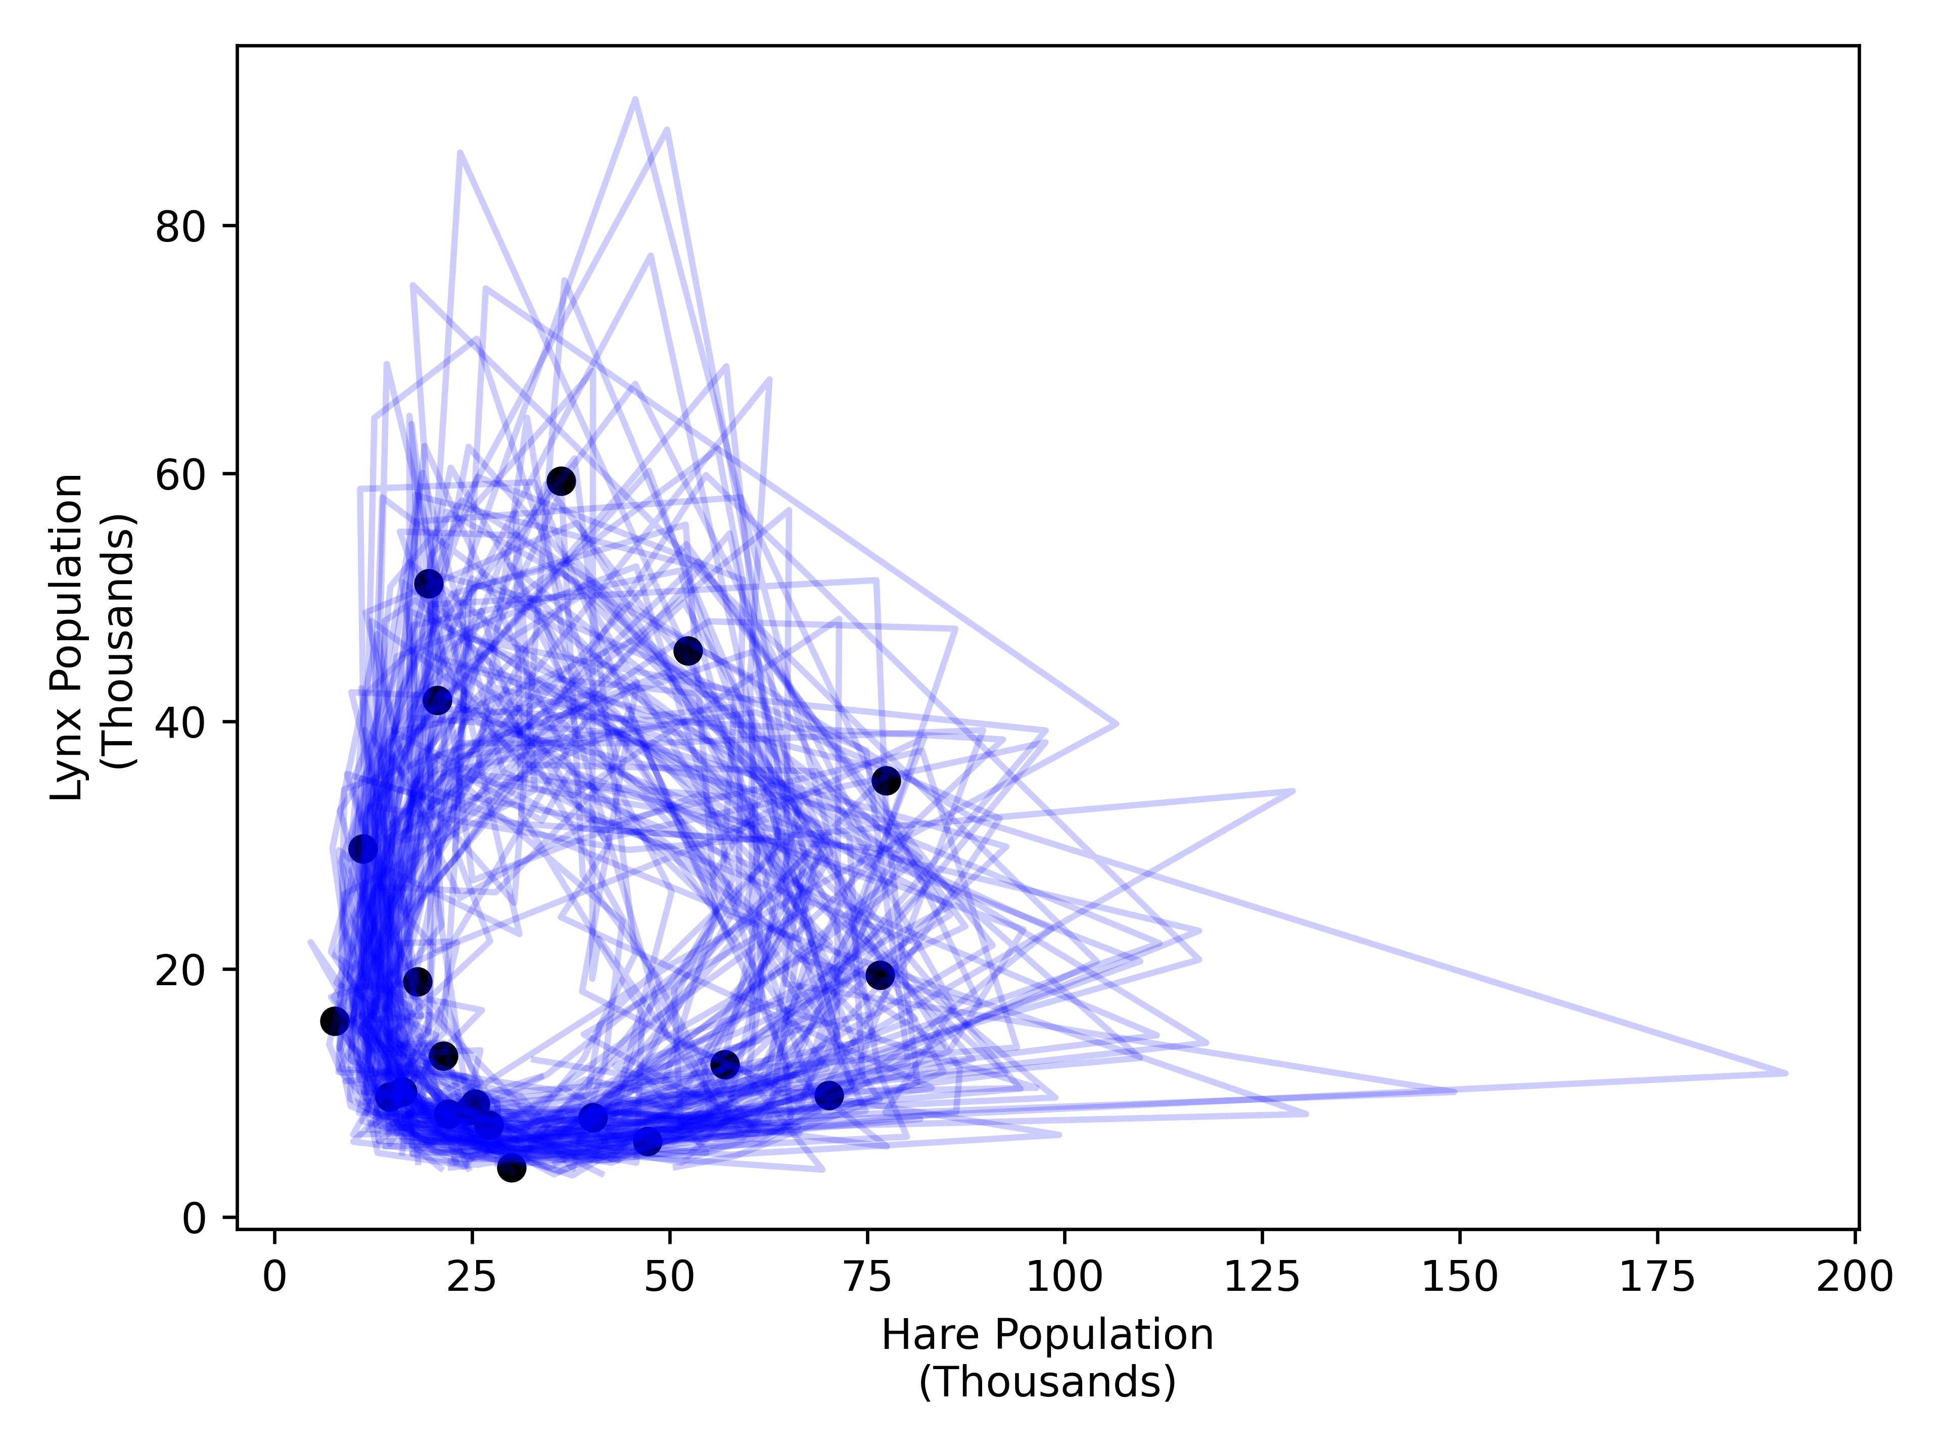
Lotka Volterra – posterior predictive

Slide 15
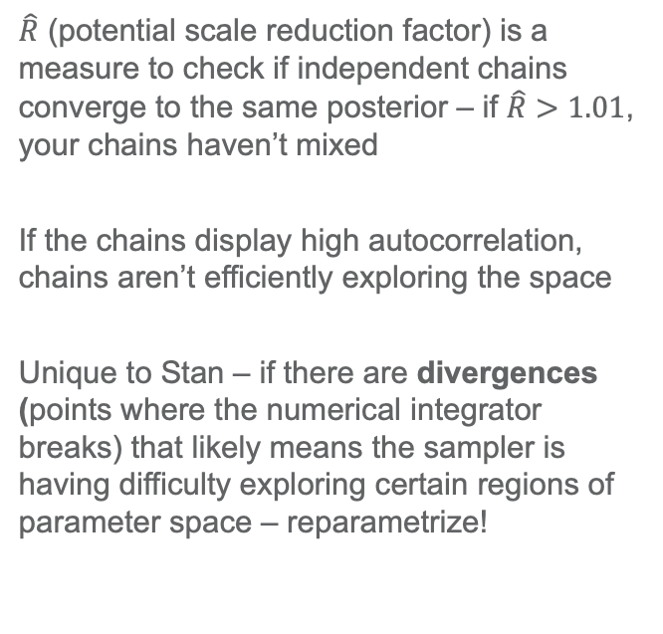
Stan example – diagnostics
$\hat{R}$ (potential scale reduction factor) is a measure to check if independent chains converge to the same posterior – if $\hat{R}>1.01$, your chains haven’t mixed
If the chains display high autocorrelation, chains aren’t efficiently exploring the space
Unique to Stan – if there are divergences (points where the numerical integrator breaks) that likely means the sampler is having difficulty exploring certain regions of parameter space – reparametrize!

Slide 16
Stan example – Pairs plots

Slide 17
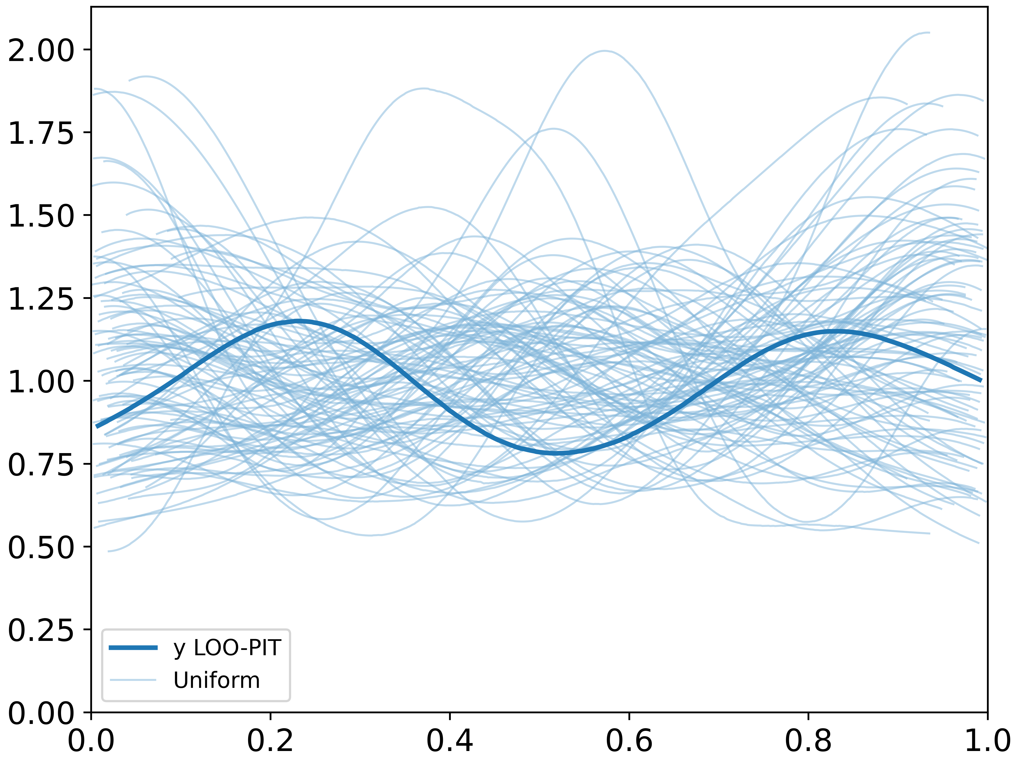
Leave-One-Out probability integral transformation (PIT) predictive checks

Slide 18
Limitations of the classic Lotka Volterra equations
In the absence of predators, the equations predict unlimited exponential growth of prey (unphysical)
The populations can become arbitrarily low and still recover – extinction is impossible
The equations are deterministic, but the system is inherently stochastic
Doesn’t consider long-term external factors (e.g. weather and infectious diseases)

Slide 19
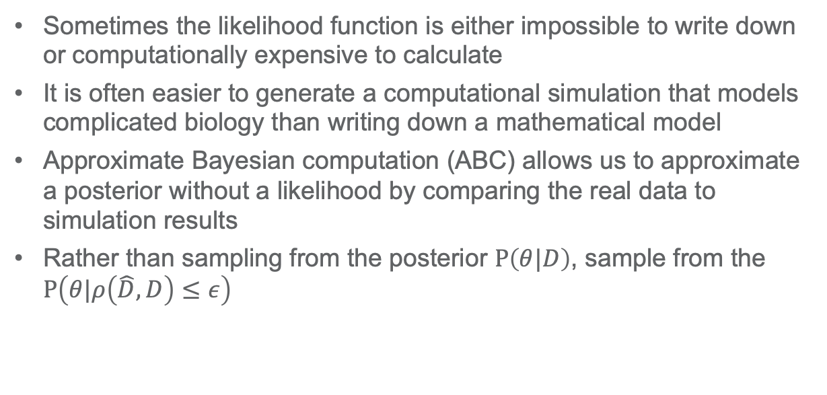
What if we don’t have a likelihood function?
Sometimes the likelihood function is either impossible to write down or computationally expensive to calculate
It is often easier to generate a computational simulation that models complicated biology than writing down a mathematical model
Approximate Bayesian computation (ABC) allows us to approximate a posterior without a likelihood by comparing the real data to simulation results
Rather than sampling from the posterior $P\left(θ|D\right)$, sample from the $P\left(θ|ρ\left(\hat{D},D\right)≤ε\right)$

Slide 20
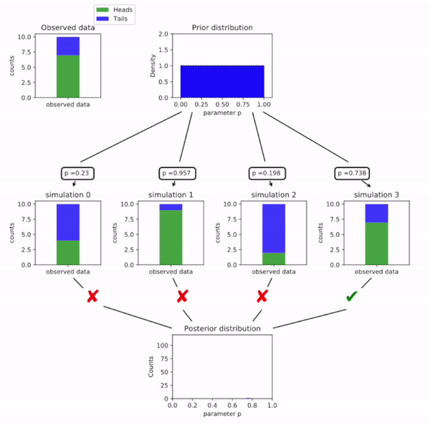
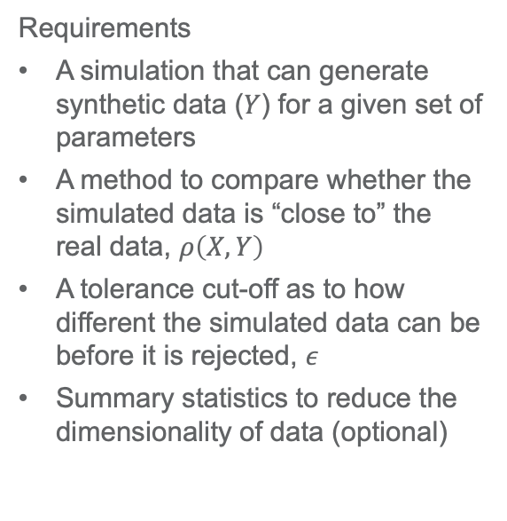
Basic ABC framework
Requirements
A simulation that can generate synthetic data ($Y$) for a given set of parameters
A method to compare whether the simulated data is “close to” the real data, $ρ\left(X,Y\right)$
A tolerance cut-off as to how different the simulated data can be before it is rejected, $ε$
Summary statistics to reduce the dimensionality of data (optional)

Slide 21
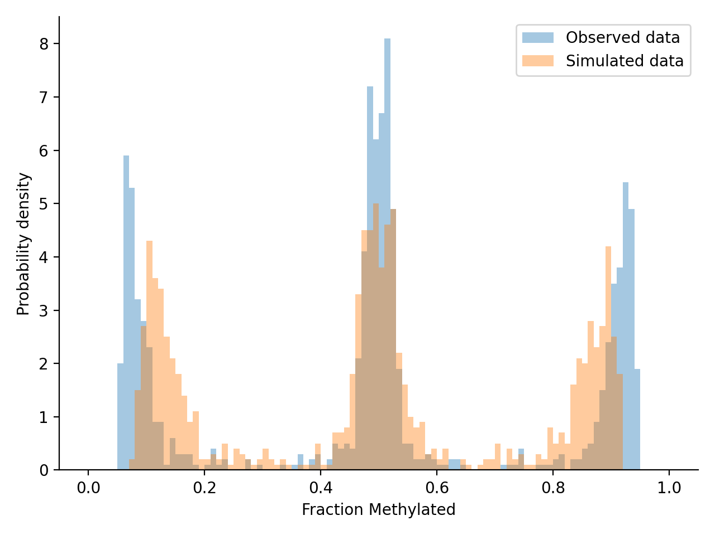
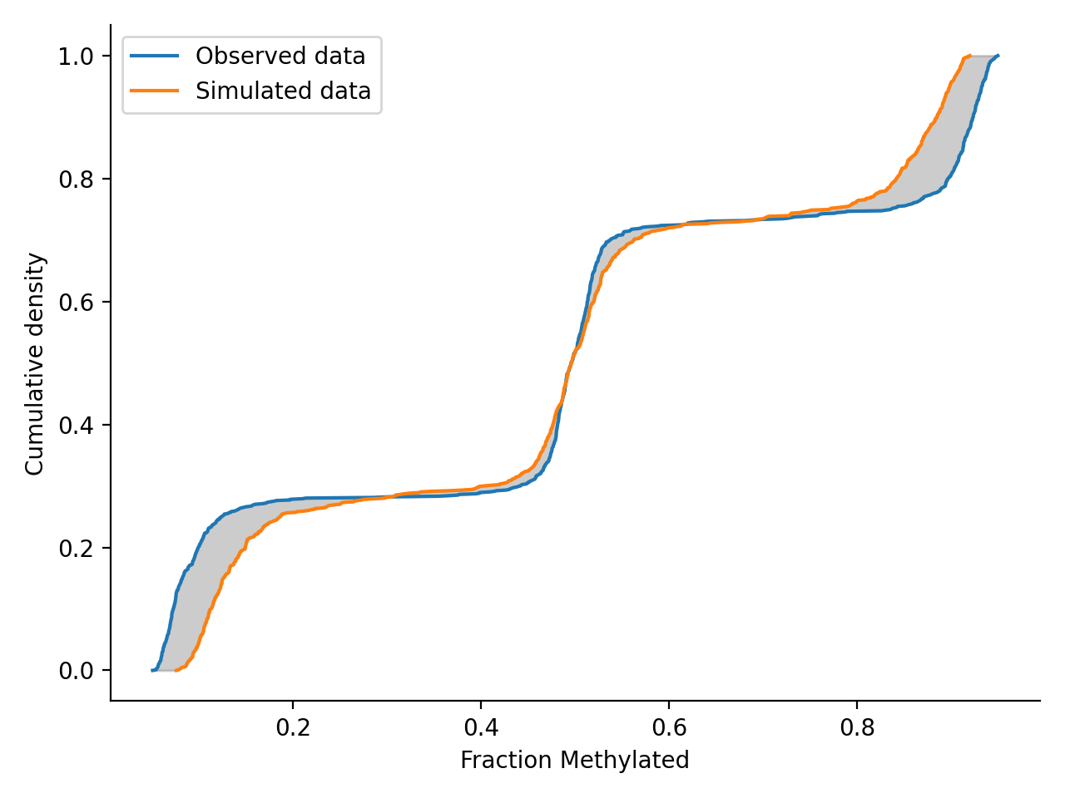
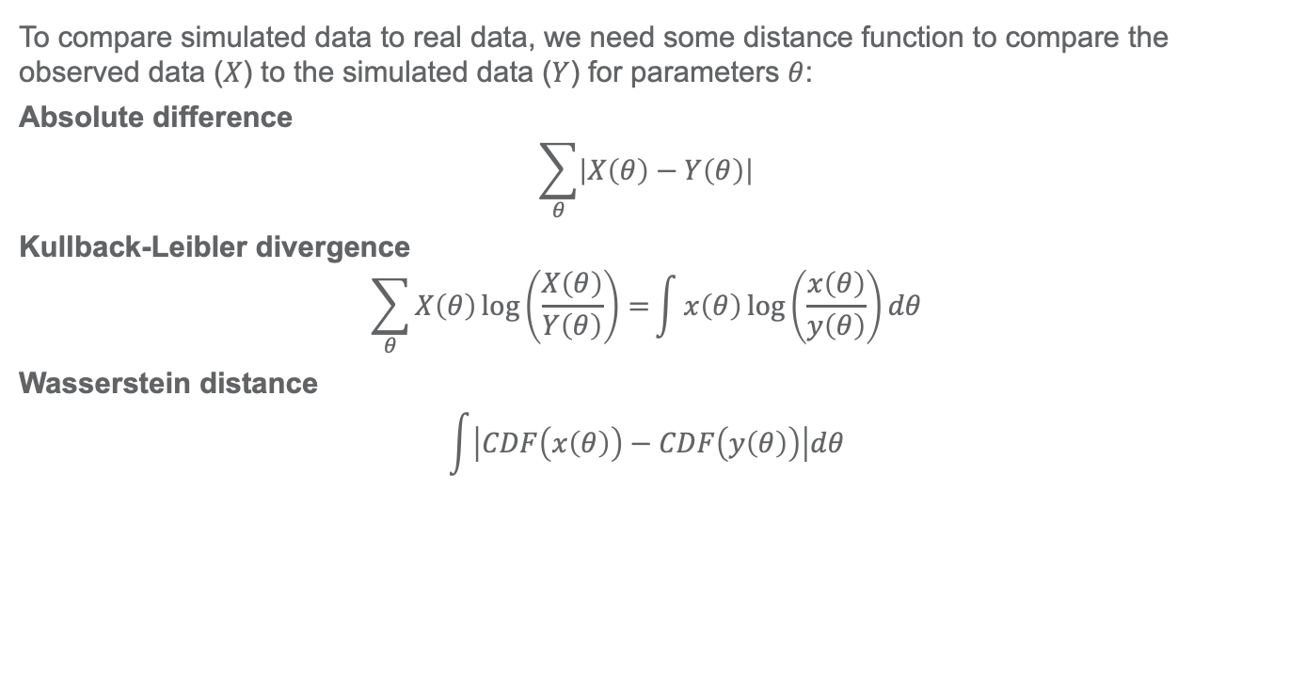
Distance metric
To compare simulated data to real data, we need some distance function to compare the observed data ($X$) to the simulated data ($Y$) for parameters $θ$:
Absolute difference
$$\sum_{θ}{\left|X\left(θ\right)−Y\left(θ\right)\right|}$$
Kullback-Leibler divergence
$$\sum_{θ}{X\left(θ\right)\log\left(\frac{X\left(θ\right)}{Y\left(θ\right)}\right)=}\int{x\left(θ\right)\log\left(\frac{x\left(θ\right)}{y\left(θ\right)}\right)dθ}$$
Wasserstein distance
$$\int{\left|CDF\left(x\left(θ\right)\right)−CDF\left(y\left(θ\right)\right)\right|dθ}$$
Wasserstein
distance
Notes:
Kullback-Leibler divergence is relative entropy: ”A simple interpretation of the divergence of X from Y is the expected excess surprise from using Y as a model when the actual distribution is X.”
Wasserstein distance is also called the “earth mover distance” and for univariate data can be considered as the difference in area between the two CDFs

Slide 22
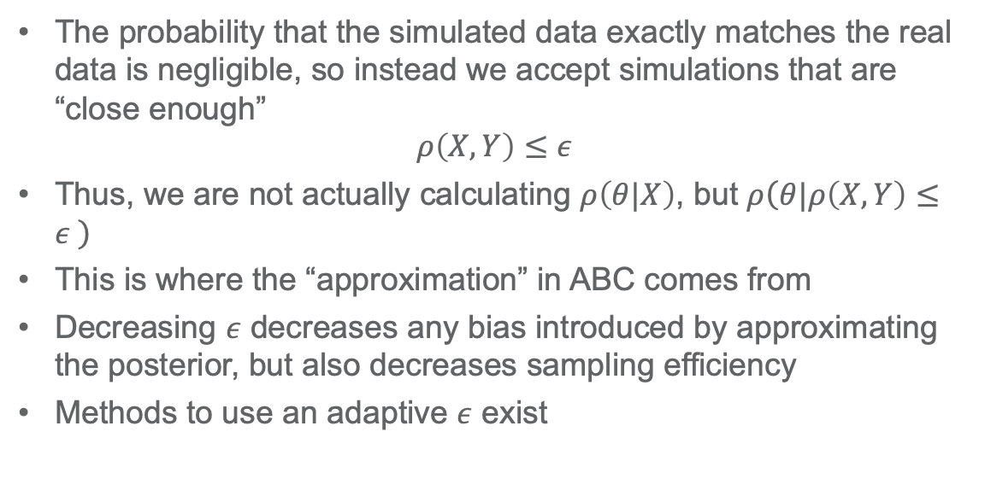
Tolerance cut-off
The probability that the simulated data exactly matches the real data is negligible, so instead we accept simulations that are “close enough”
$$ρ\left(X,Y\right)≤ε$$
Thus, we are not actually calculating $ρ\left(θ|X\right)$, but $ρ\left(θ|ρ\left(X,Y\right)≤ε \right)$
This is where the “approximation” in ABC comes from
Decreasing $ε$ decreases any bias introduced by approximating the posterior, but also decreases sampling efficiency
Methods to use an adaptive $ε$ exist

Slide 23
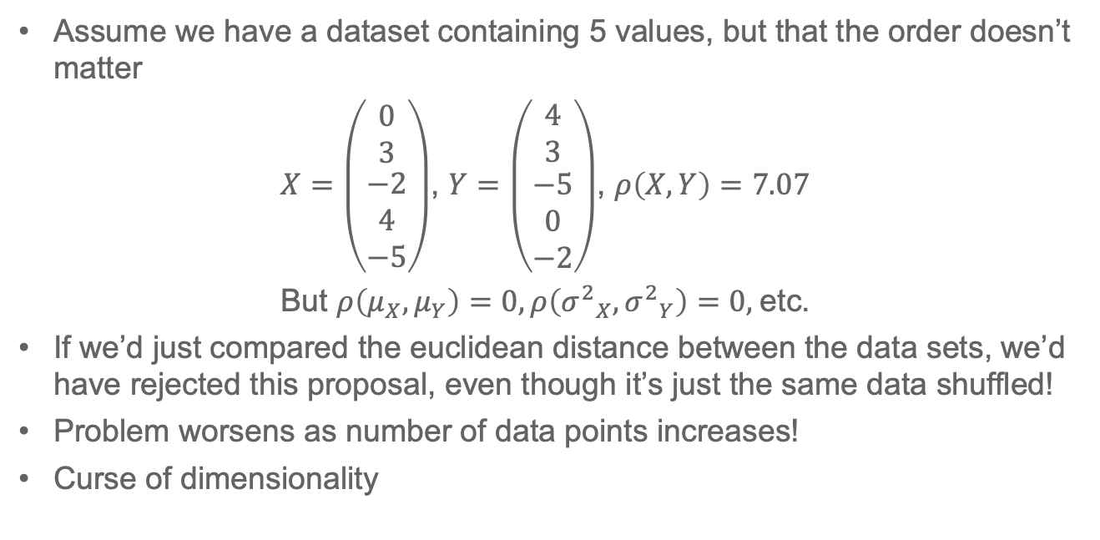
Summary statistics
Assume we have a dataset containing 5 values, but that the order doesn’t matter
$X=\left(\begin{matrix}0 \\ 3 \\ \begin{matrix}−2 \\ 4 \\ −5\end{matrix}\end{matrix}\right)$, $Y=\left(\begin{matrix}4 \\ 3 \\ \begin{matrix}−5 \\ 0 \\ −2\end{matrix}\end{matrix}\right)$, $ρ\left(X,Y\right)=7.07$
But $ρ\left(μ_{X},μ_{Y}\right)=0, ρ\left({σ^{2}}_{X},{σ^{2}}_{Y}\right)=0,$etc.
If we’d just compared the euclidean distance between the data sets, we’d have rejected this proposal, even though it’s just the same data shuffled!
Problem worsens as number of data points increases!
Curse of dimensionality
Notes:
Often, rather than compare the synthetic data to the observed data directly, we want to use summary statistics to reduce the dimensionality of the output space, improving efficiency.

Slide 24
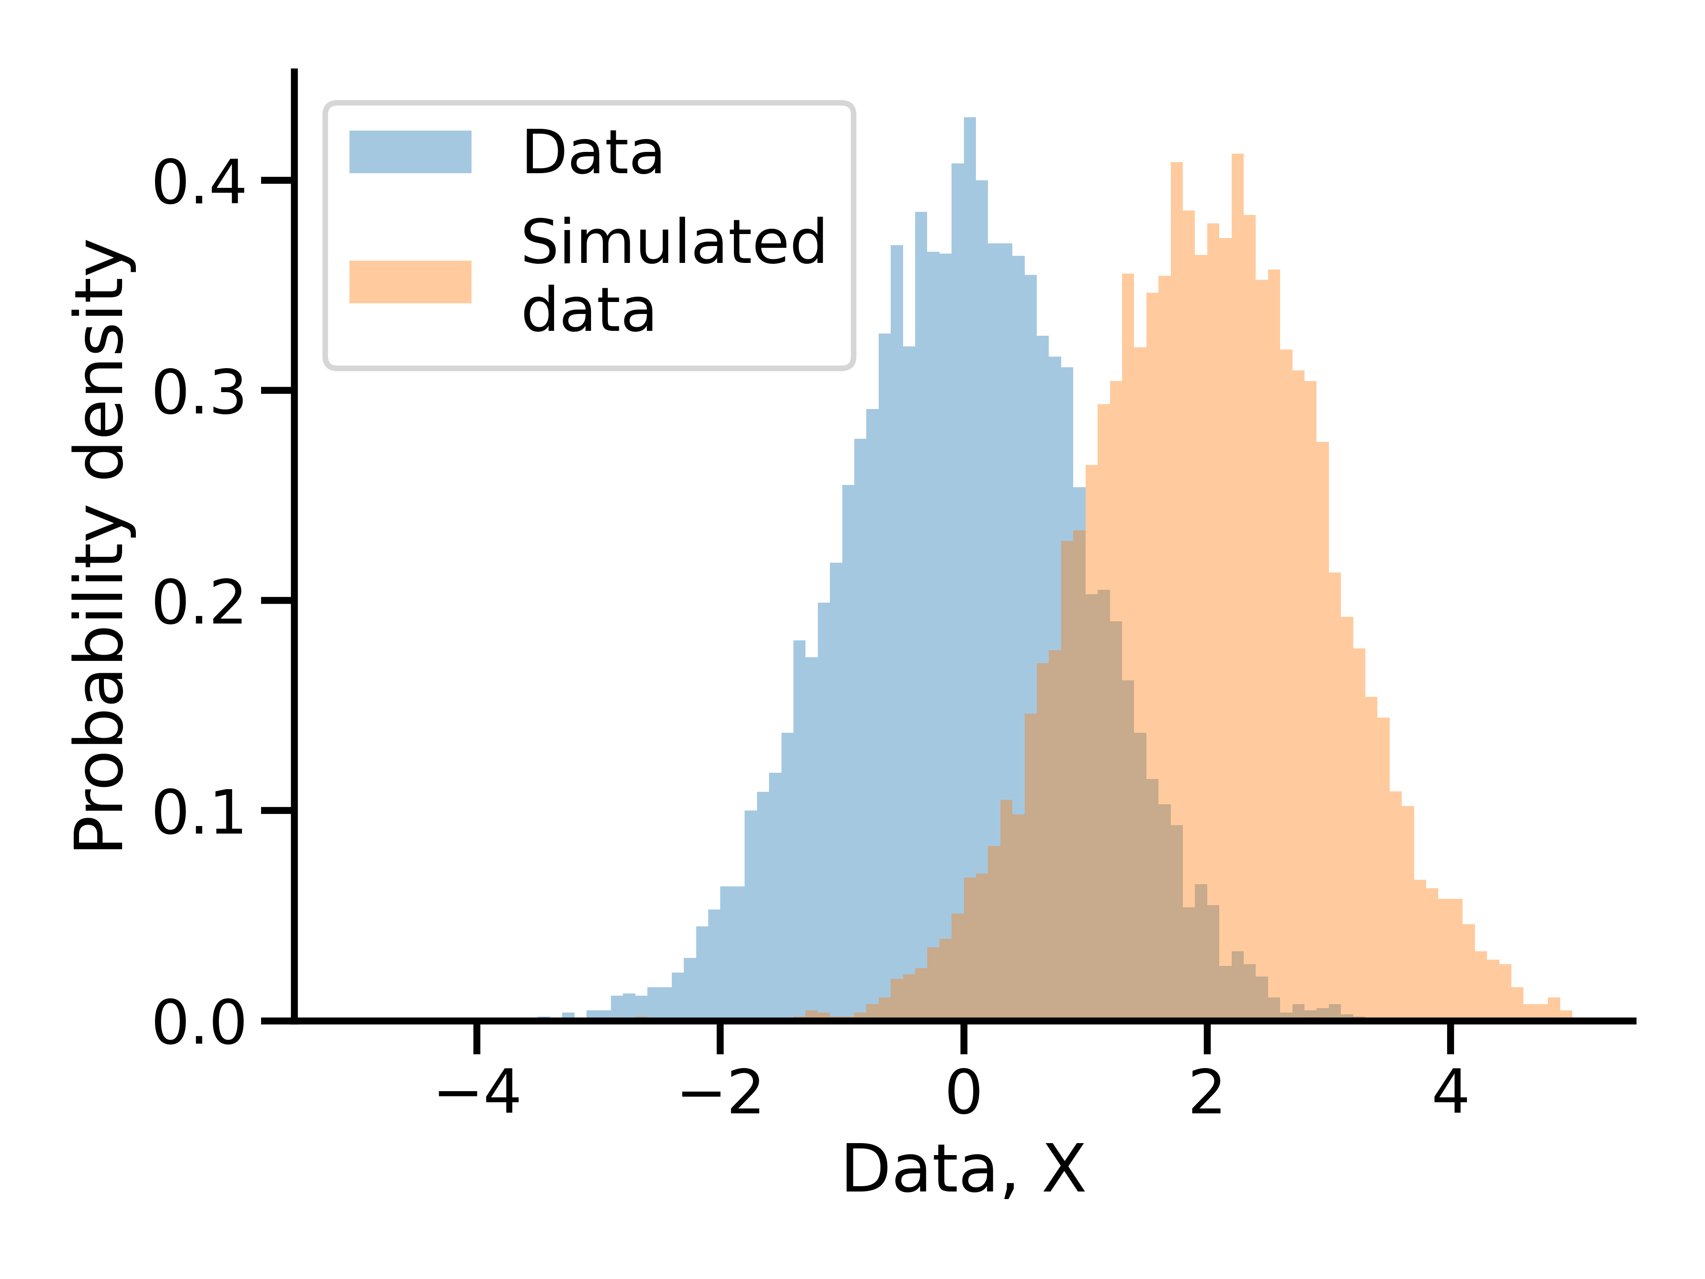
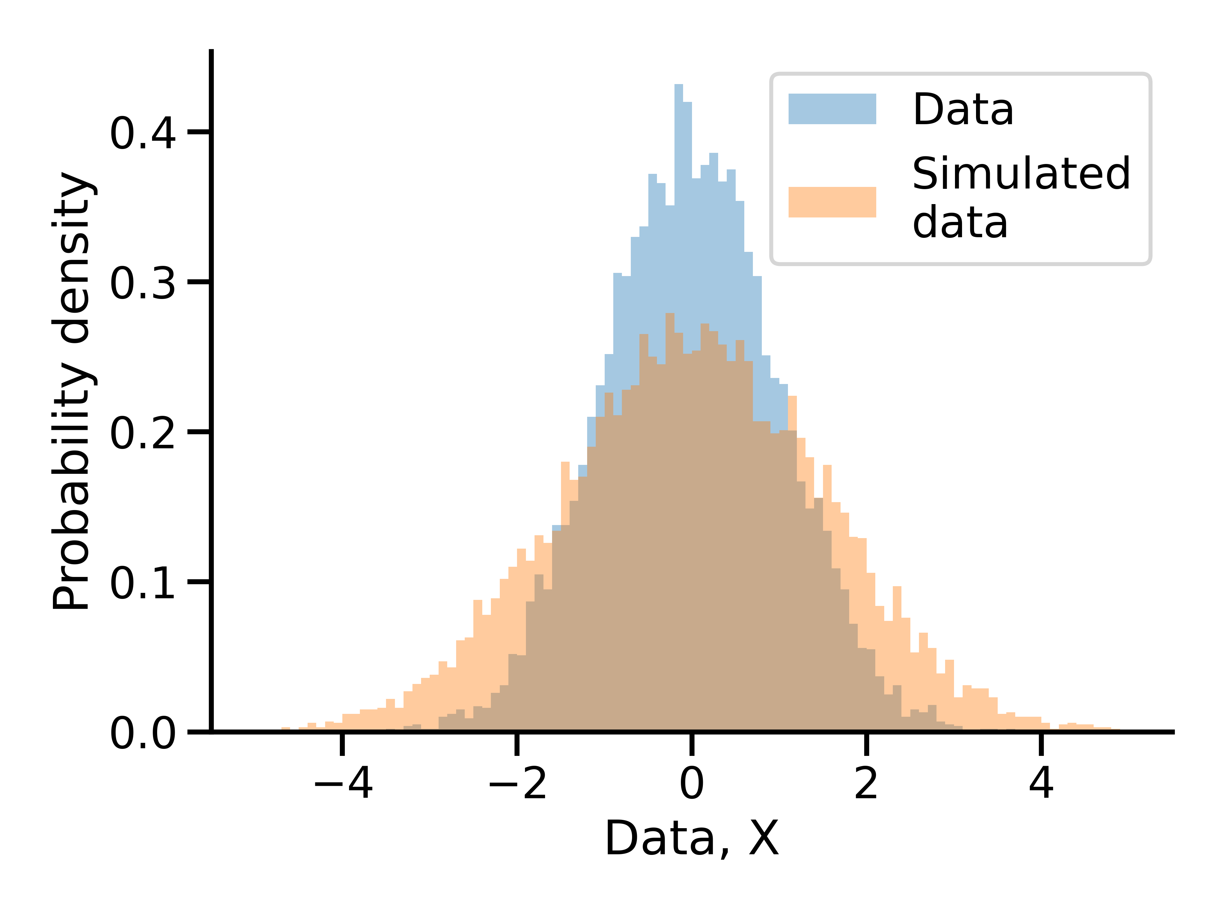
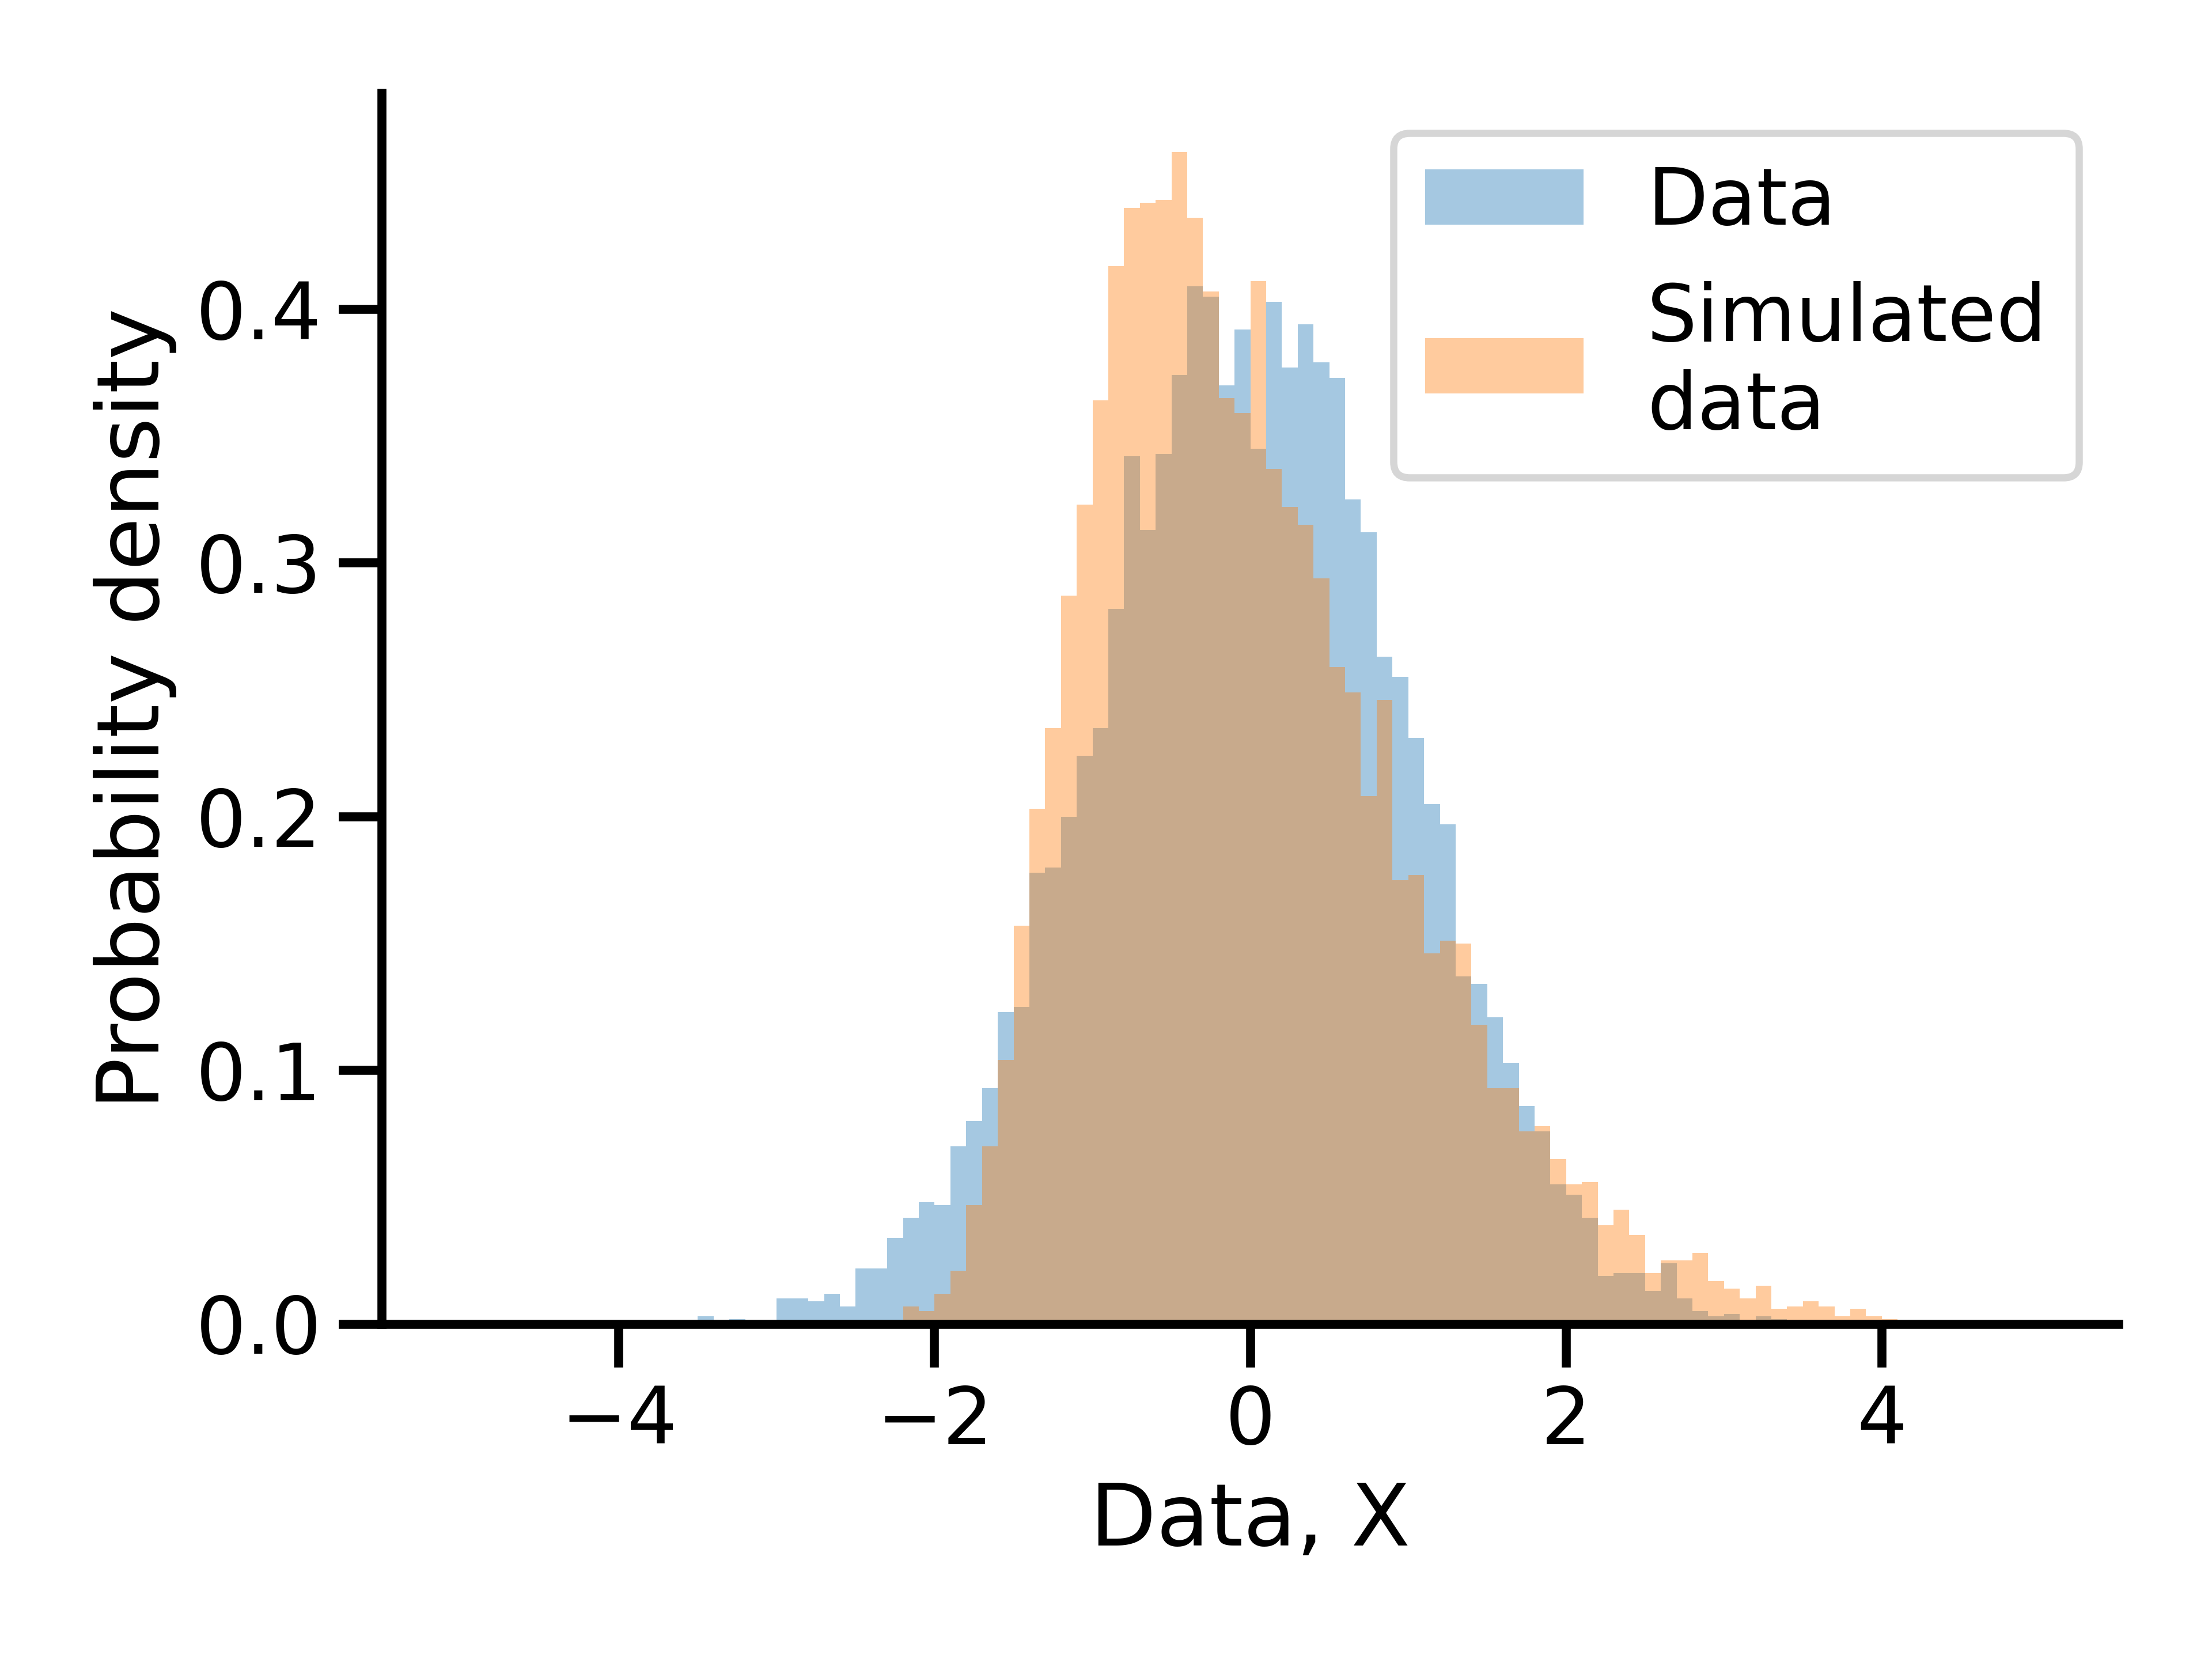
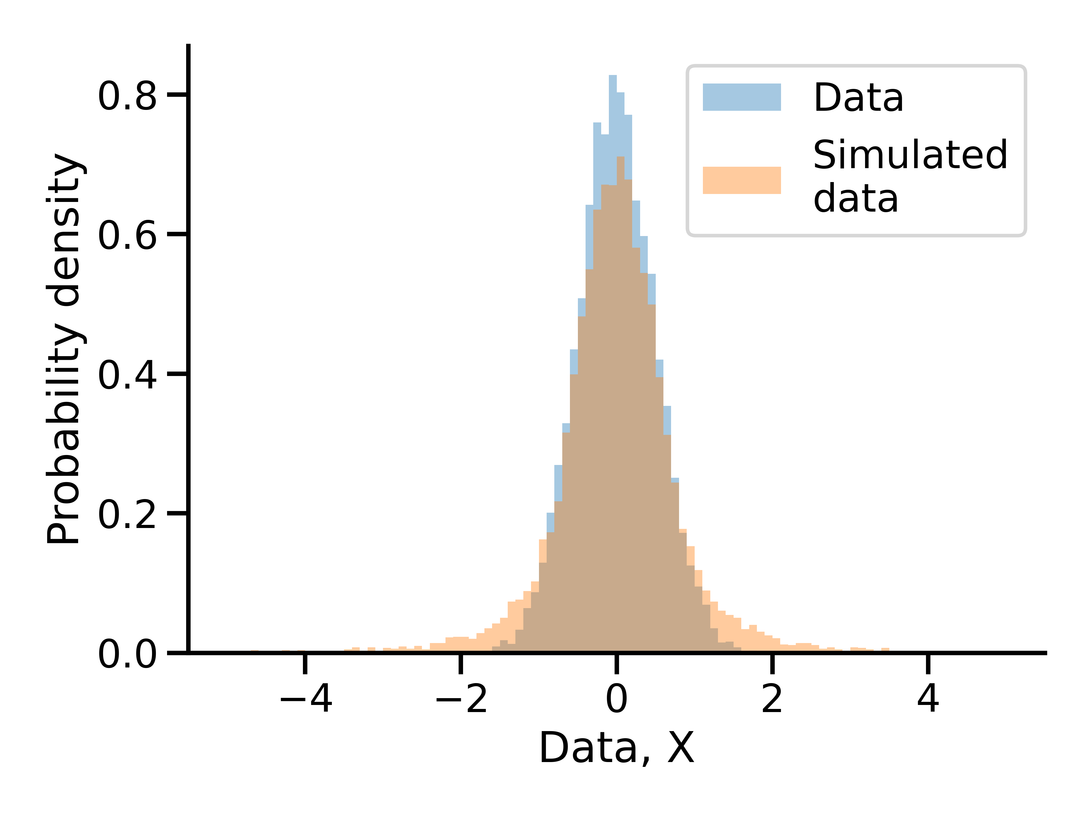
Sufficient summary statistics
Need enough summary statistics to wholly represent the observed datasets, but too many summary statistics also decreases sampling efficiency
Means
Variance
Kurtosis
Skew

Slide 25
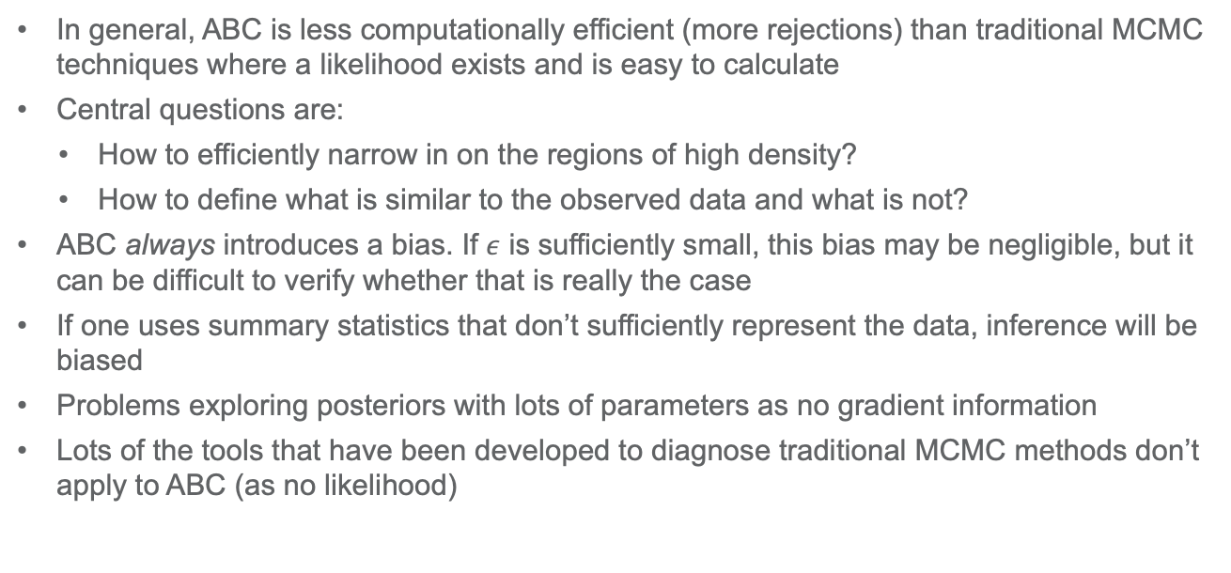
Drawbacks of ABC
In general, ABC is less computationally efficient (more rejections) than traditional MCMC techniques where a likelihood exists and is easy to calculate
Central questions are:
How to efficiently narrow in on the regions of high density?
How to define what is similar to the observed data and what is not?
ABC always introduces a bias. If $ε$ is sufficiently small, this bias may be negligible, but it can be difficult to verify whether that is really the case
If one uses summary statistics that don’t sufficiently represent the data, inference will be biased
Problems exploring posteriors with lots of parameters as no gradient information
Lots of the tools that have been developed to diagnose traditional MCMC methods don’t apply to ABC (as no likelihood)

Slide 26

ABC algorithms
So far, we’ve focused on rejection ABC, but more complicated ABC algorithms exist
Mainly focused on using existing existing points in the posterior to suggest new points, increasing sampling efficiency
Examples
MCMC ABC
Sequential Monte Carlo ABC
Population Monte Carlo ABC
Simulated annealing ABC
Generally much more efficient than rejection based methods, but samples are not necessarily independently drawn from posterior
Adaptive $ε$
Notes:
MCMC ABC – random walk using position of current proposal to generate next proposal using a Metropolis-Hastings rejection step
Sequential Monte Carlo ABC – sequence of (decreasing) tolerances. Construct intermediate posterior for $ε_{1}$ + calculate a weight for each accepted particle. Sample the intermediate posterior according to weights + generate a new proposal according to a perturbation kernel and accept with tolerance $ε_{2}$. Repeat until final tolerance $ε_{T}$.
Population Monte Carlo ABC – Similar to SMC, but PMC uses importance sampling weights for pruning the sample instead of accepting or rejecting a given particle, so every step of the process yields samples from the posterior. E.g. Sample from proposal distribution on parameter space. Accept only "close" parameters. Reduce tolerance. New proposal distribution. Adjust the sampled proportions by multiplying by weight = π/g to account for the fact we’re sampling from the proposal distribution rather than the prior. Samples more from high density regions of the posterior.
SMC and PMC are iterated importance samplers.

Slide 27
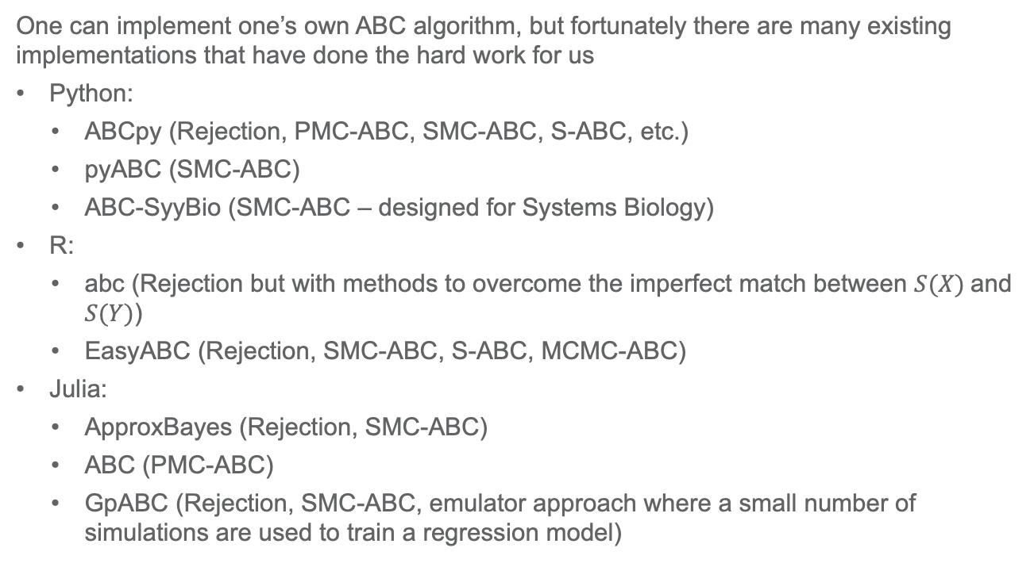
ABC software
One can implement one’s own ABC algorithm, but fortunately there are many existing implementations that have done the hard work for us
Python:
ABCpy (Rejection, PMC-ABC, SMC-ABC, S-ABC, etc.)
pyABC (SMC-ABC)
ABC-SyyBio (SMC-ABC – designed for Systems Biology)
R:
abc (Rejection but with methods to overcome the imperfect match between $S(X)$and $S(Y)$)
EasyABC (Rejection, SMC-ABC, S-ABC, MCMC-ABC)
Julia:
ApproxBayes (Rejection, SMC-ABC)
ABC (PMC-ABC)
GpABC (Rejection, SMC-ABC, emulator approach where a small number of simulations are used to train a regression model)

